Slide 1
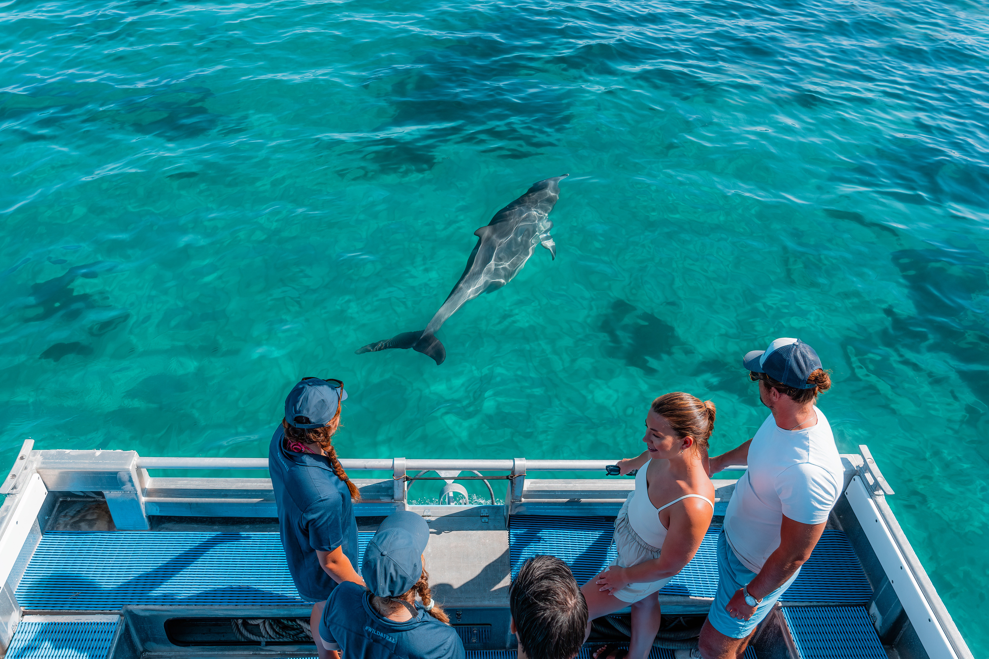

TOURISM & HOSPITALITY
CAREERS PRESENTATION
2026
Notes:
Image: Working Holiday Maker at Perth Wildlife Encounters, Rockingham Credit: Tourism WA Image Library
This presentation has been created as a resource for teachers to share with students.
1

Slide 2

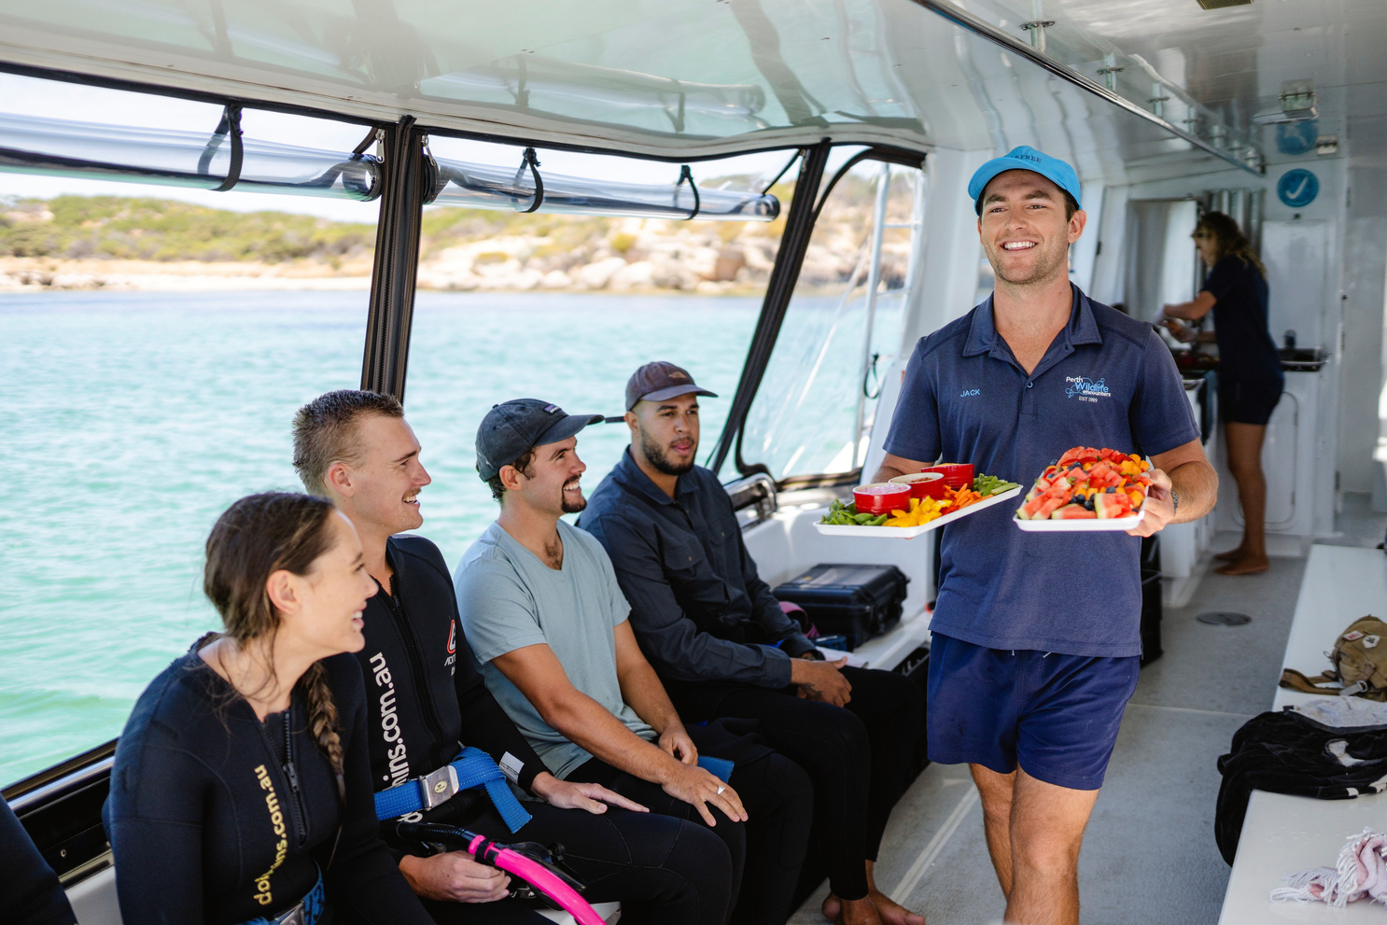

WHAT IS TOURISM?
Tourism is about creating experiences for people when they travel away from home for holidays, business, or adventure.
Plan
Travel & Stay
Enjoy
Who Works in Tourism?
Travel Consultants
Tour Operators
Tour Guides
Visitor Information Hosts
Attraction Staff
Tourism Covers Many Industries
Accommodation
Food & Beverage
Conferences & Events
Transport
Retail
Sport, Recreation & Entertainment
Tourism connects people to places, cultures, nature and creates exciting career opportunities.
Notes:
Top Image: Serving food during a “Swim with Wild Dolphins” boat tour at Perth Wildlife Encounters in Rockingham, WA. Credit: Tourism Western Australia Image Library
Bottom Image: Working with animals and people at Caversham Wildlife Park, WA. Credit: Tourism Western Australia Image Library
Background information for teachers:
Travel and Tourism
Tourism involves providing goods and services for people’s leisure and business activities when away from home.
It extends from pre-trip services such as reservations to delivery of tourism products such as tours at the destination.
The Tourism and Travel industry typically comprises a workforce across travel agents, tour guides, adventure tour guides, visitor information centres, tourist attractions and cultural tourism operators.
Tourism is also the umbrella term for a vast range of associated sectors spanning accommodation, food and beverage services, conferences and events, transport (including cruise shipping, aviation, car hire, sightseeing transport), retail, sport and recreation services (including stadia and other sporting venues), International Education and the Cultural sectors.
Reference: Travel & Tourism - FutureNow – Creative and Leisure Industries Training Council Inc
Industry snapshot: futurenow_travel_and_tourism_snapshot_2023.pdf
The Future of Tourism Demand: tourism-australia-future-of-demand-market-snapshots-v2

Slide 3
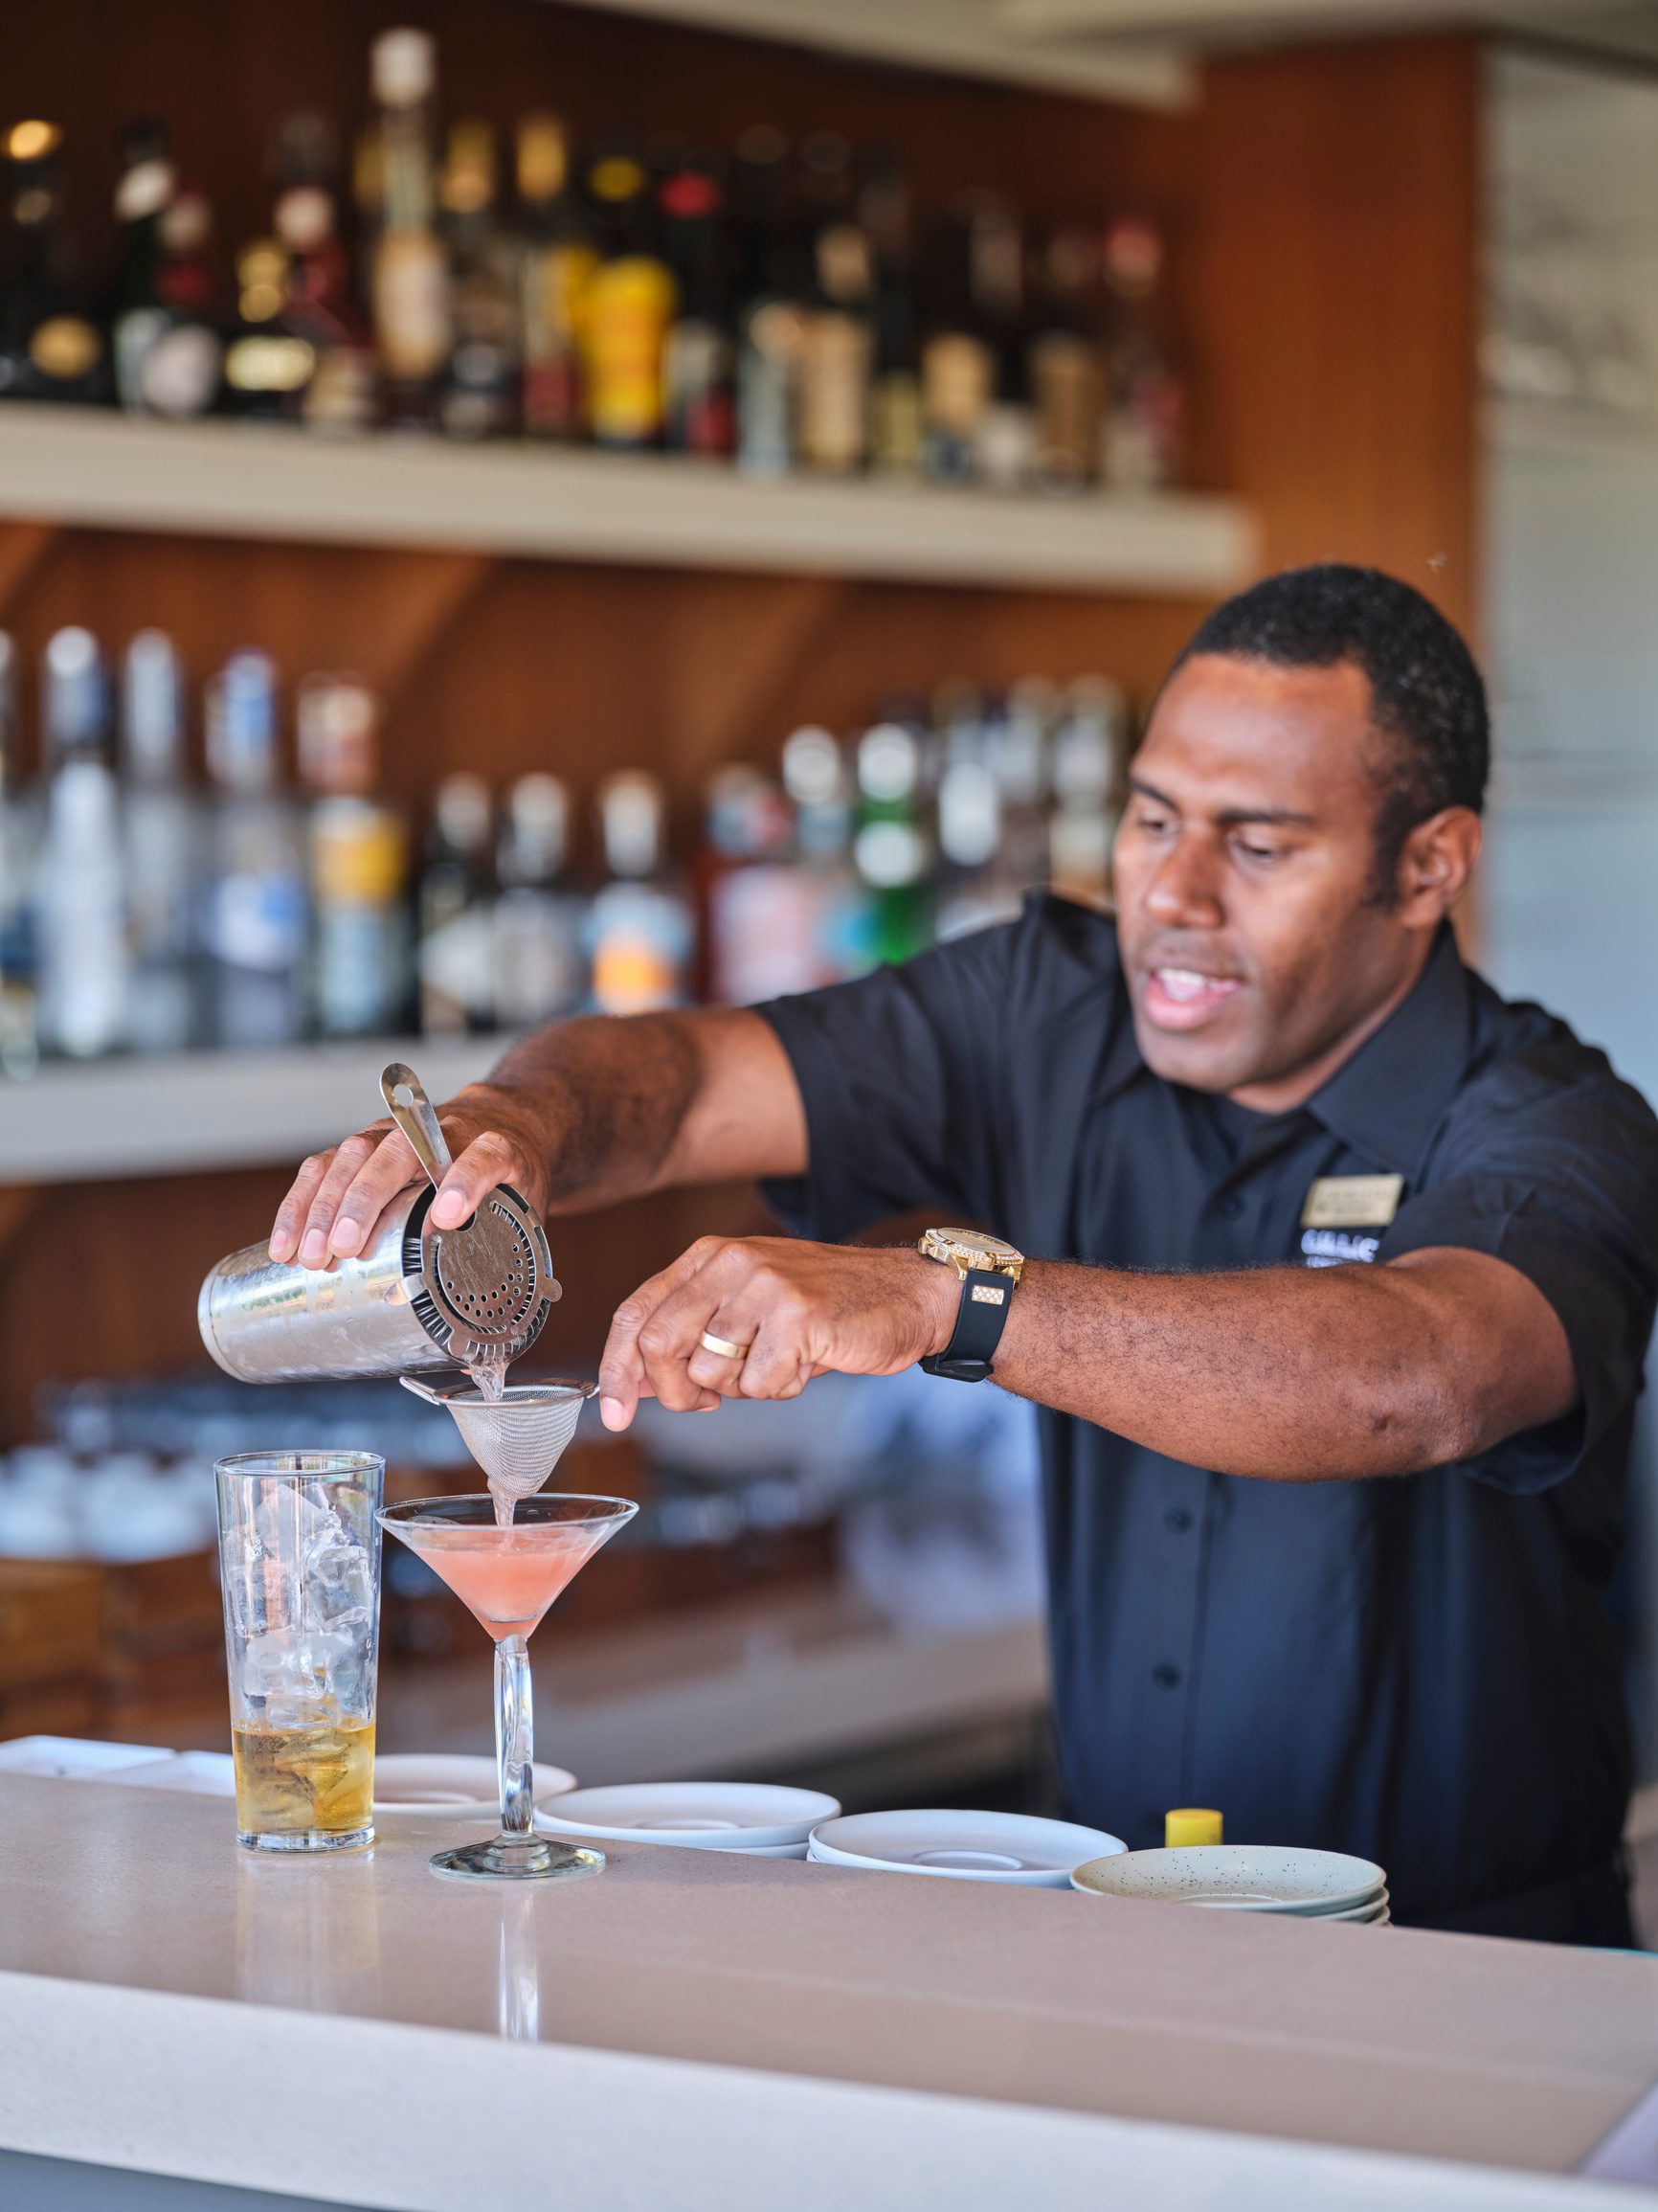

WHAT IS HOSPITALITY?
Hospitality is all about making people feel welcome and creating memorable experiences.
Care
Comfort
Experience
Where Does Hospitality Happen?
Hotels, resorts & caravan parks
Cafés, restaurants & bars
Airlines, cruise ships & transport services
Stadiums, theme parks & entertainment venues
Hospitality works with tourism to make sure visitors enjoy their stay, feel comfortable, and want to come back.
Notes:
Top image: Cable Beach Club, Broome WA. Credit: Tourism Western Australia Image Library
Bottom Image: Mantarays Ningaloo Beach Resort, Exmouth WA. Credit: Tourism Western Australia Image Library
Note for teachers.
Hospitality
The Hospitality Industry encompasses a broad group of workers that provide service to customers primarily in the Food & Beverage and Accommodation sectors. Workers in hospitality are the creators of memorable customer experiences in public social spaces, or providers of sustenance for people in aged care, childcare, and hospitals; students in the education sector; and workers in the resources sector. Workers engaged in the Accommodation sector provide services to visitors in hotels, serviced apartments, resorts and caravan parks, as well as for workers in the resources sector.
Industry snapshot: futurenow_hospitality_snapshot_a_2023.pdf

Slide 4























TOURISM ADDS VALUE EVERY STEP OF THE WAY!
TRAVELLERS
Lodging
Air
Cruise Lines
Motor Coach
Automobile
Train
Sports Arena
Amusement
Campground
RV
Fuel
Meetings/Conventions
Retail
Bank
Farm
School
Travel Agency
Food
Entertainment
SALES, EMPLOYMENT, WAGES. TAXES
Outside Goods & Services
Local Goods & Services
Notes:
In 2023-24, there were 120,100 tourism filled jobs, a growth of 5 per cent on 2022-23. (Tourism Satellite Report)
In 2023-2024, visitor spend in WA was $15.9 Bil value (Gross State Product) – this is direct and indirect spending.
Aspirational goal for visitor spend to grow to $25 billion per annum by 2033.
More spend, more infrastructure, more opportunities, more jobs.
The State Government has a 10-year road map for the future of the state’s visitor economy.
The Western Australia Visitor Economy Strategy 2033 (WAVES) outlines a vision for Western Australia ‘to be recognised as a world-class destination that immerses people in its unique cultures, communities, and environment’.
Infographic from: Economic benefits – ART (regionaltourism.com.au)

Slide 5
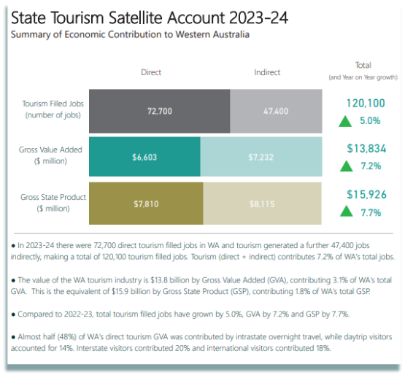
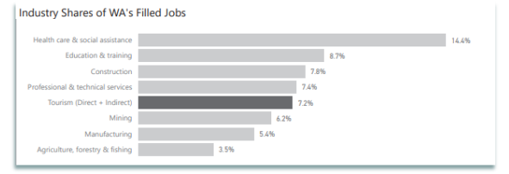
WA VISITOR ECONOMY WORKFORCE
Source: 2023-2024 State Tourism Satellite Account
Notes:
In 2023-2024 there was $15.9 Bil value (Gross State Product)
Aspirational goal for visitor spend to grow to $25 billion per annum by 2033.
More spend, more infrastructure, more opportunities, more jobs.
The State Government has a 10-year road map for the future of the state’s visitor economy.
The Western Australia Visitor Economy Strategy 2033 (WAVES) outlines a vision for Western Australia ‘to be recognised as a world-class destination that immerses people in its unique cultures, communities, and environment’.
Read more about the WA Visitor Economy Strategy here: Tourism WA: Western Australia Visitor Economy Strategy 2033

Slide 6
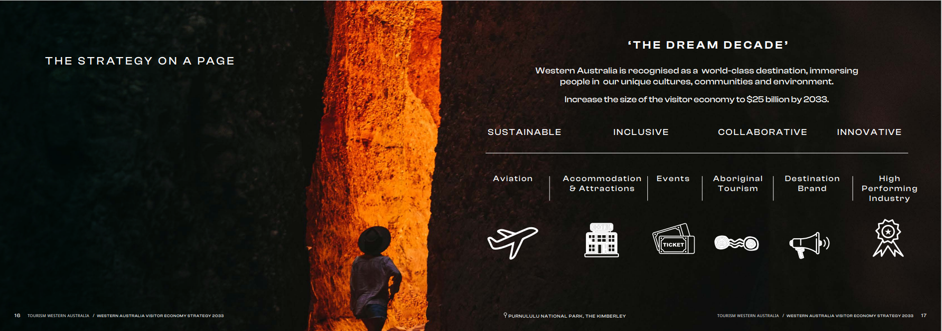
WESTERN AUSTRALIA’S
VISITOR ECONOMY
Aspirational goal for visitor spend to grow to $25 billion per annum by 2033.
Notes:
In 2023-2024 there was $15.9 Bil value (Gross State Product)
Aspirational goal for visitor spend to grow to $25 billion per annum by 2033.
More spend, more infrastructure, more opportunities, more jobs.
The State Government has a 10-year road map for the future of the state’s visitor economy.
The Western Australia Visitor Economy Strategy 2033 (WAVES) outlines a vision for Western Australia ‘to be recognised as a world-class destination that immerses people in its unique cultures, communities, and environment’.
Read more about the WA Visitor Economy Strategy here: Tourism WA: Western Australia Visitor Economy Strategy 2033

Slide 7
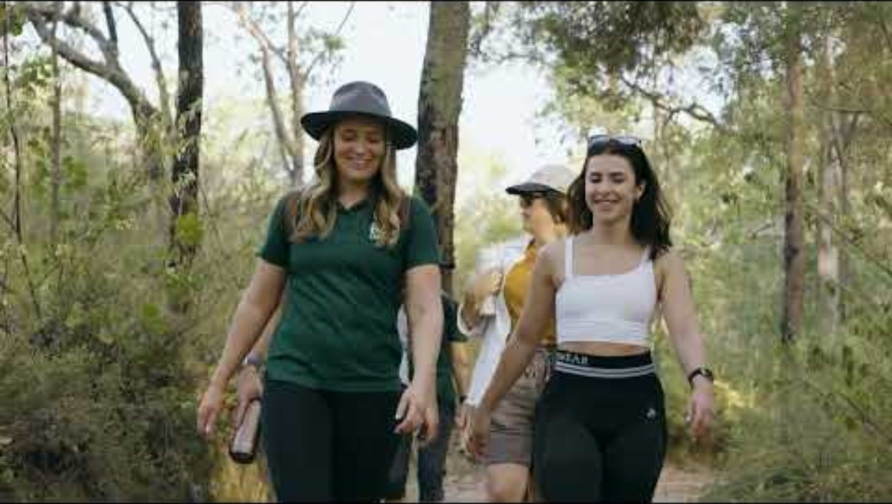
Notes:
See Western Australia’s Tourism and Hospitality industry in full swing - Press Play to watch a 90 second video. Credit: Tourism WA Image Library.
5

Slide 8
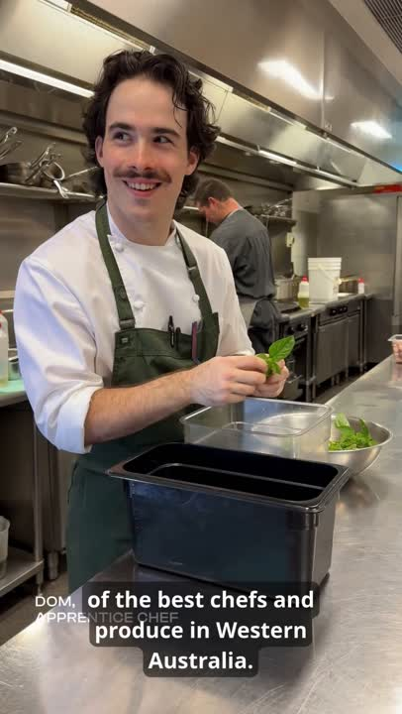
WHY TOURISM AND
HOSPITALITY?
Tourism & Hospitality is one of Western Australia’s fastest-growing industries with real jobs, real pathways, and real opportunities.
  In-Demand Jobs in WA
Food & Service
Chefs • Cooks • Front of House
Travel & Tourism
Tour Guides • Visitor Services • Cabin Crew • Pilots • Deckhands • Skippers • Coach Guides
Behind the Scenes
Finance • Business Admin • HR • Marketing • PR
Management & Events
Hotel Management • Venue Management • Events Management
Notes:
Reference: 2023 Jobs and Skills Australia The Skills Priority List (SPL) - https://jobsandskills.gov.au/data/skills-priority-list
Click play on the video to be inspired by from Dom and apprentice chef at the State Buildings.

Slide 9
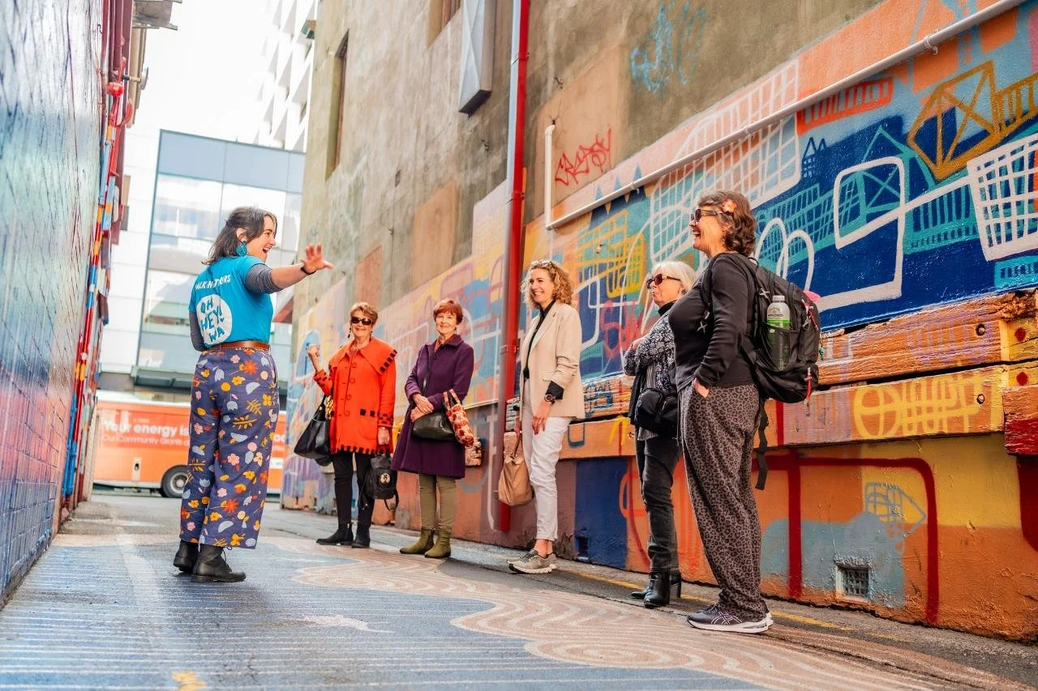
WHERE CAN I WORK?
Global Employers
Offering Career Pathways
Work with international brands like Crown, Hilton, Accor,
Ritz-Carlton, and Marriott International,
offering opportunities to grow and travel.
Travel & Work Opportunities
Work across Western Australia and overseas in resorts, cruise ships, airlines, events and seasonal destinations.
Western Australian Employers
Build your career with places such as Rottnest Island resorts, RAC, Prendiville Group, and
AHA WA venue members.
Local Businesses & Attractions
Start close to home with cafés, restaurants, tour operators, hotels, and WA state attractions in your own community.
Apprenticeships &
Paid Training
Earn while you learn through school apprenticeships, traineeships, and on-the-job training.

Slide 10
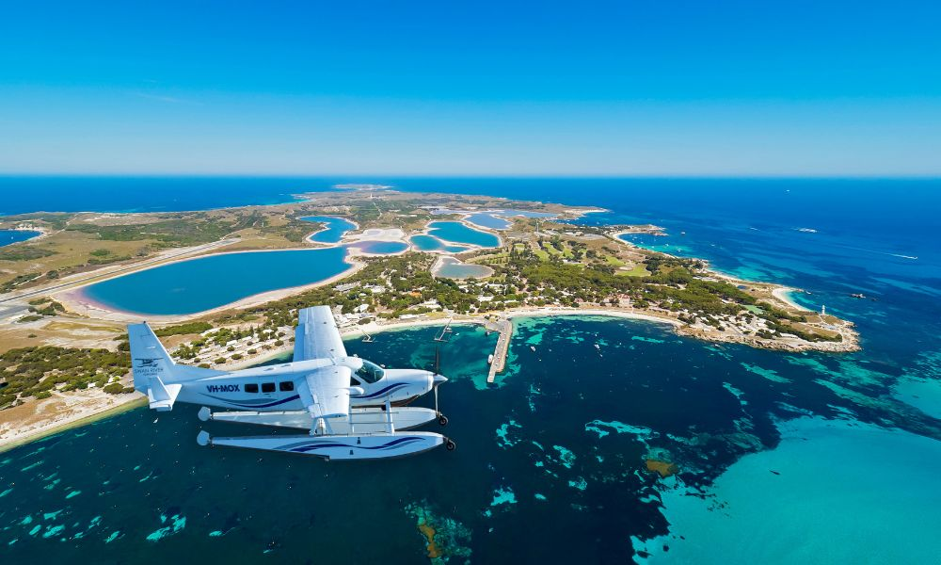

WA Tourism: Big Opportunities
Tourism in WA is growing fast, with over one million visitors visiting in 2025. With more events, experiences, and new hotels opening, there are more job opportunities than ever.
  Tourism is now the fifth largest employer in the state, making up 7.2% of all jobs in WA.
  What’s Being Built in WA?
​Perth Airports five-billion-dollar upgrade to bring thousands of
  international visitors​
  Perth Park Burswood​
  Perth Surf Park​
  Aboriginal Culture Centre​
  Regional Adventure Trails ​
  Perth Concert Hall Renovation
  Camping with Custodians​
  Aquarium WA Expansion​
  Murujuga National Park​
  New hotels, venues + more jobs

Slide 11
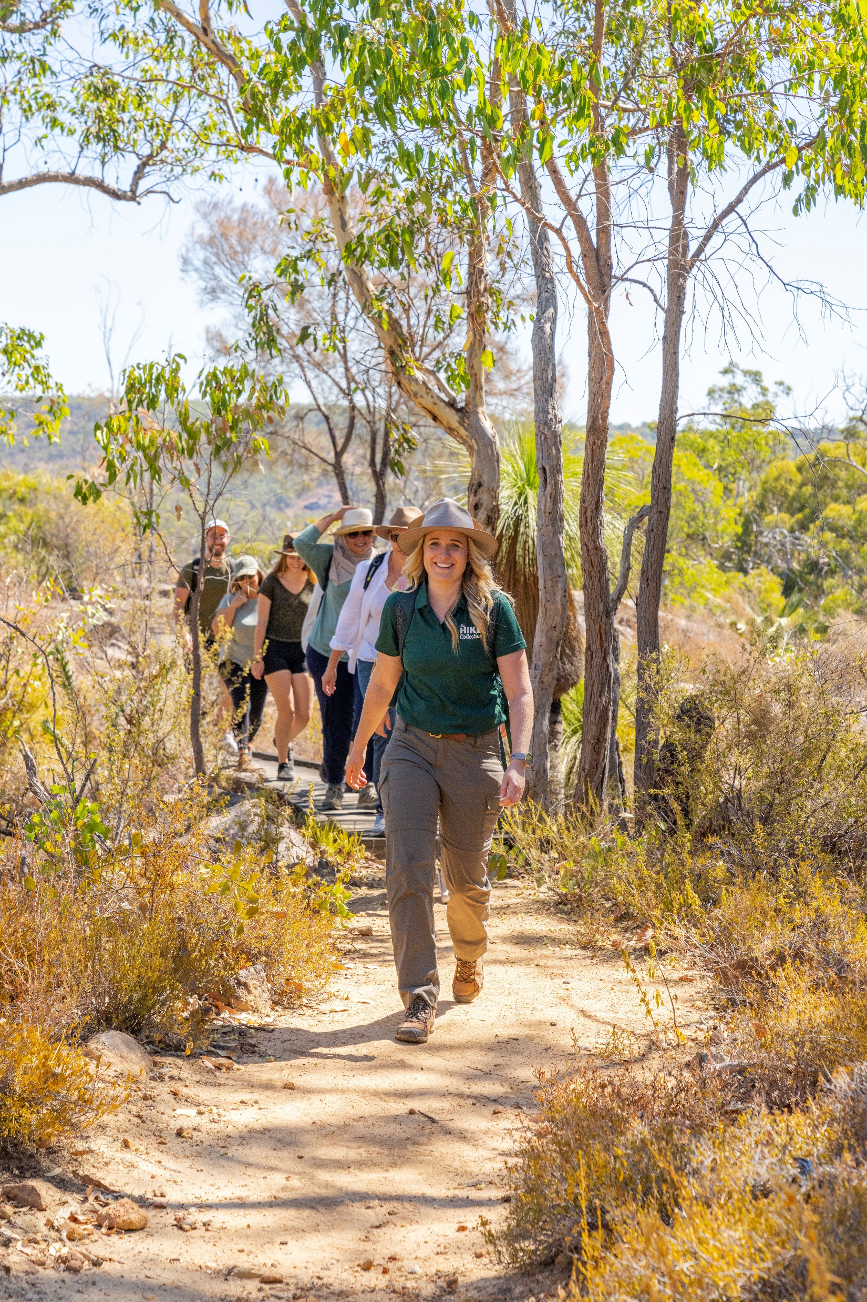
WHY TOURISM AND HOSPITALITY?
It’s full of amazing opportunities in extraordinary places!
  Why Choose This Industry
  Skills Gained in the Industry
Many Benefits
Include
Travel and work anywhere
Meet people from
around the world
Creative, active, and social jobs
Clear pathways from
school to career
Work in-demand roles across a variety of industries
Communication
Time management
Customer service
Leadership
Marketing & sales
Problem solving
Cultural awareness
Teamwork
Digital & booking systems
Great Start - Entry Level
People Power
Flexible Hours
Super Skills
Extra Perks
These skills support student capability development and give them transferable, employable skills.
Notes:
Here are just some of the perks you’ll discover when you step into the wonderful world of tourism and hospitality:
1. FLEXIBLE HOURS
Are you a student or parent? Perhaps you’re a night owl? The tourism and hospitality industry offers great flexibility in working hours for those seeking a better work/life balance. It’s not uncommon for businesses to operate 24 hours, seven days a week, so there are so many options to suit your circumstances and lifestyle.
2. PEOPLE POWER
The tourism and hospitality industry attracts people from all over the world, whether as guests, patrons or employees. You’ll interact with a diverse range of people from different cultures, gender and age, increase your understanding of others and use those skills to solve problems, thus enhancing future job prospects. And each day will bring new ideas and opportunities.
3. GREAT START
No experience? No worries! Many employers are more concerned about the kind of attitude you have because the jobs are customer facing or rely on teamwork. You can learn on the job from the best.
4. SUPER SKILLS
Not only will you learn skills to further progress in the industry, but you can also develop skills to apply in your personal life. Want to know how to manage your time better? Make small talk with ease? Create fancy cocktails? The WA tourism and hospitality industry is full of experts who can help you develop in so many ways.
5. EXTRA PERKS
There can be other rewards besides your weekly wage. Some employers offer staff discounts at their venue and affiliated venues. Many local pubs, restaurants and hotels also offer generous ‘hospo’ (hospitality) rates, or take advantage of industry rates offered by tour companies and accommodation providers to the local WA tourism and hospitality community. Some of the best benefits are the contacts you make along the way, which can lead to your next adventure.
6. ENDLESS OPPORTUNITIES
How would you like a career in an industry that employs almost one million people in more than 300,000 businesses across Australia? Tourism and hospitality can take you around the country and the world. Where will your adventure in the tourism and hospitality industry take you?
7

Slide 12
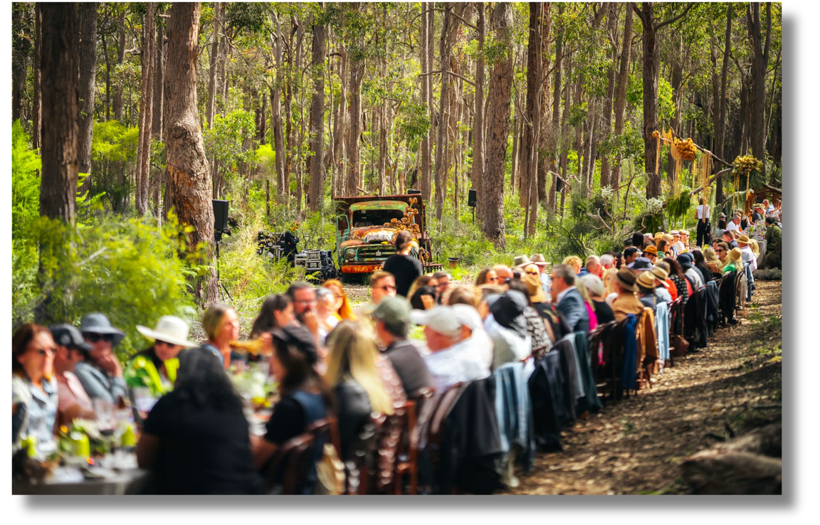

Major Events Coming to WA
  SPORTS
  Rugby World Cup 2027​
  World Master Games 2029​
  Australian Rowing Championships (2027/30)
  World Gay Games XIII in 2030
  ARTS & CULTURE
  Fringe, Taste Great Southern, Crab Fest, Pair’d, Ord Valley Muster, Karijini Experience​
  Total Solar Eclipse Kimberley 2028​
  ​
  Huge demand for workers in all areas for Events + Tourism + Hospitality!!

Slide 13






HOSPITALITY CAREER PATHWAYS
Education
Job/Outcome
Job Description
Certificate II in:
Cookery
Hospitality
Baking
Accommodation: Front office assistant, room attendant.
Food and Beverage: Waiter or bar attendant, gaming attendant.
Cookery: Cook, kitchen hand, kitchen attendant
Accommodation: customer service duties, cleaning/serving rooms, interaction with customers.
Food and Beverage: customer service duties, taking customer orders, serving food and beverages.
Cookery: Basic cook duties in hospitality catering
Accommodation: Receptionist, night auditor, concierge, porter / butler, laundry attendant, room attendant.
Food and Beverage: Waitstaff, bar / cocktail staff
Cookery: Qualified chef in any hospitality establishment.
Accommodation: A team leader in Accommodation has the skills and knowledge to perform a broad range of operational tasks and to lead a small team.
Food and Beverage: A team leader in Food and Beverage has the skills and knowledge to perform a broad range of operational tasks and to lead a small team.
Cookery: Prepare food according to menus. Examine food to ensure quality. Regulate temperatures of ovens, grills and other cooking equipment. Store food in temperature-controlled facilities. Prepare food according to health and hygiene regulations.
Certificate III in:
Commercial Cookery (Apprenticeship level)
Hospitality
Baking
Patisserie
Accommodation: Front office or housekeeping supervisor.
Food & Beverage: Restaurant Supervisor Catering Supervisor
Cookery: Executive Chef, Head Chef, Sous Chef.
Catering: Catering Supervisor.
Certificate IV in:
Commercial Cookery
Hospitality
Patisserie
Accommodation: A supervisor in accommodation with day-to-day operational responsibilities.
Food and Beverage: A supervisor in food and beverage with operational responsibilities.
Cookery: Manage and operate a catering or kitchen complex. Plan menus and supervise.
kitchen staff to prepare, cook and serve food and wine to dining areas.
Catering: Catering supervisor in a Hospitality workplace.
Diploma of Hospitality Management
Advanced Diploma of Hospitality Management
Bachelor of Hospitality and Tourism Management
(Year 12 entry with ATAR, Credits are available for TAFE Diploma and Cert IV students at some Universities)
Accommodation: Rooms division manager, Operations manager.
Food and Beverage: Hospitality manager, Food and Beverage manager, Club secretary/manager, Restaurant/café owner, Hotel/motel owner/manager.
Plan and control a range of hospitality products; market the establishment, manage maintenance, equipment, premises, and outlets. Maintain business compliance within legislation requirements, manage financial operations and develop business plans. Lead, manage and supervise teams.

Slide 14




TOURISM CAREER PATHWAYS
Certificate II in: Tourism • Travel • Customer Service
Certificate III in: Tourism • Travel • Guiding • Events
Certificate IV in: Tourism • Travel & Tourism
START YOUR JOURNEY (Entry Level)
Visitor Information Host
Tourism Assistant
Attraction Attendant
Reservations Officer
Ticketing Officer
Guest Services Officer
Help visitors, sell tickets, manage bookings and share local knowledge.
BUILD EXPERIENCE (Skilled Roles)
Tour Guide
Eco / Sustainability Guide
Adventure Guide
Travel Consultant
Visitor Experience Officer
Events Assistant
Deliver tours, create experiences, ensure safety and engage guests.
STEP UP (Supervisory Roles)
Senior Tour Guide
Visitor Services Supervisor
Tour Operations Supervisor
Events Coordinator
Reservations Manager
Lead small teams, manage daily operations and service standards.
Diploma of Travel & Tourism Management
Diploma of Event Management
Advanced Diploma of Tourism Management
Bachelor of Tourism, Hospitality & Event Management
(Year 12 entry with ATAR, Credits are available
for TAFE Diploma and Cert IV students at some Universities)
WA TOURISM STREAMS
  Eco & Sustainability Tourism
  Coastal & Marine Tourism
  Aboriginal Tourism
  Events Tourism
  Transport Tourism
  Regional Tourism
LEAD THE INDUSTRY (Management & Leadership)
Tourism Operations Manager
Destination Manager
Tour Company Manager
Events Manager
Product Development Manager
Tourism Business Owner
Manage people, budgets, marketing, partnerships and future tourism growth.

Slide 15
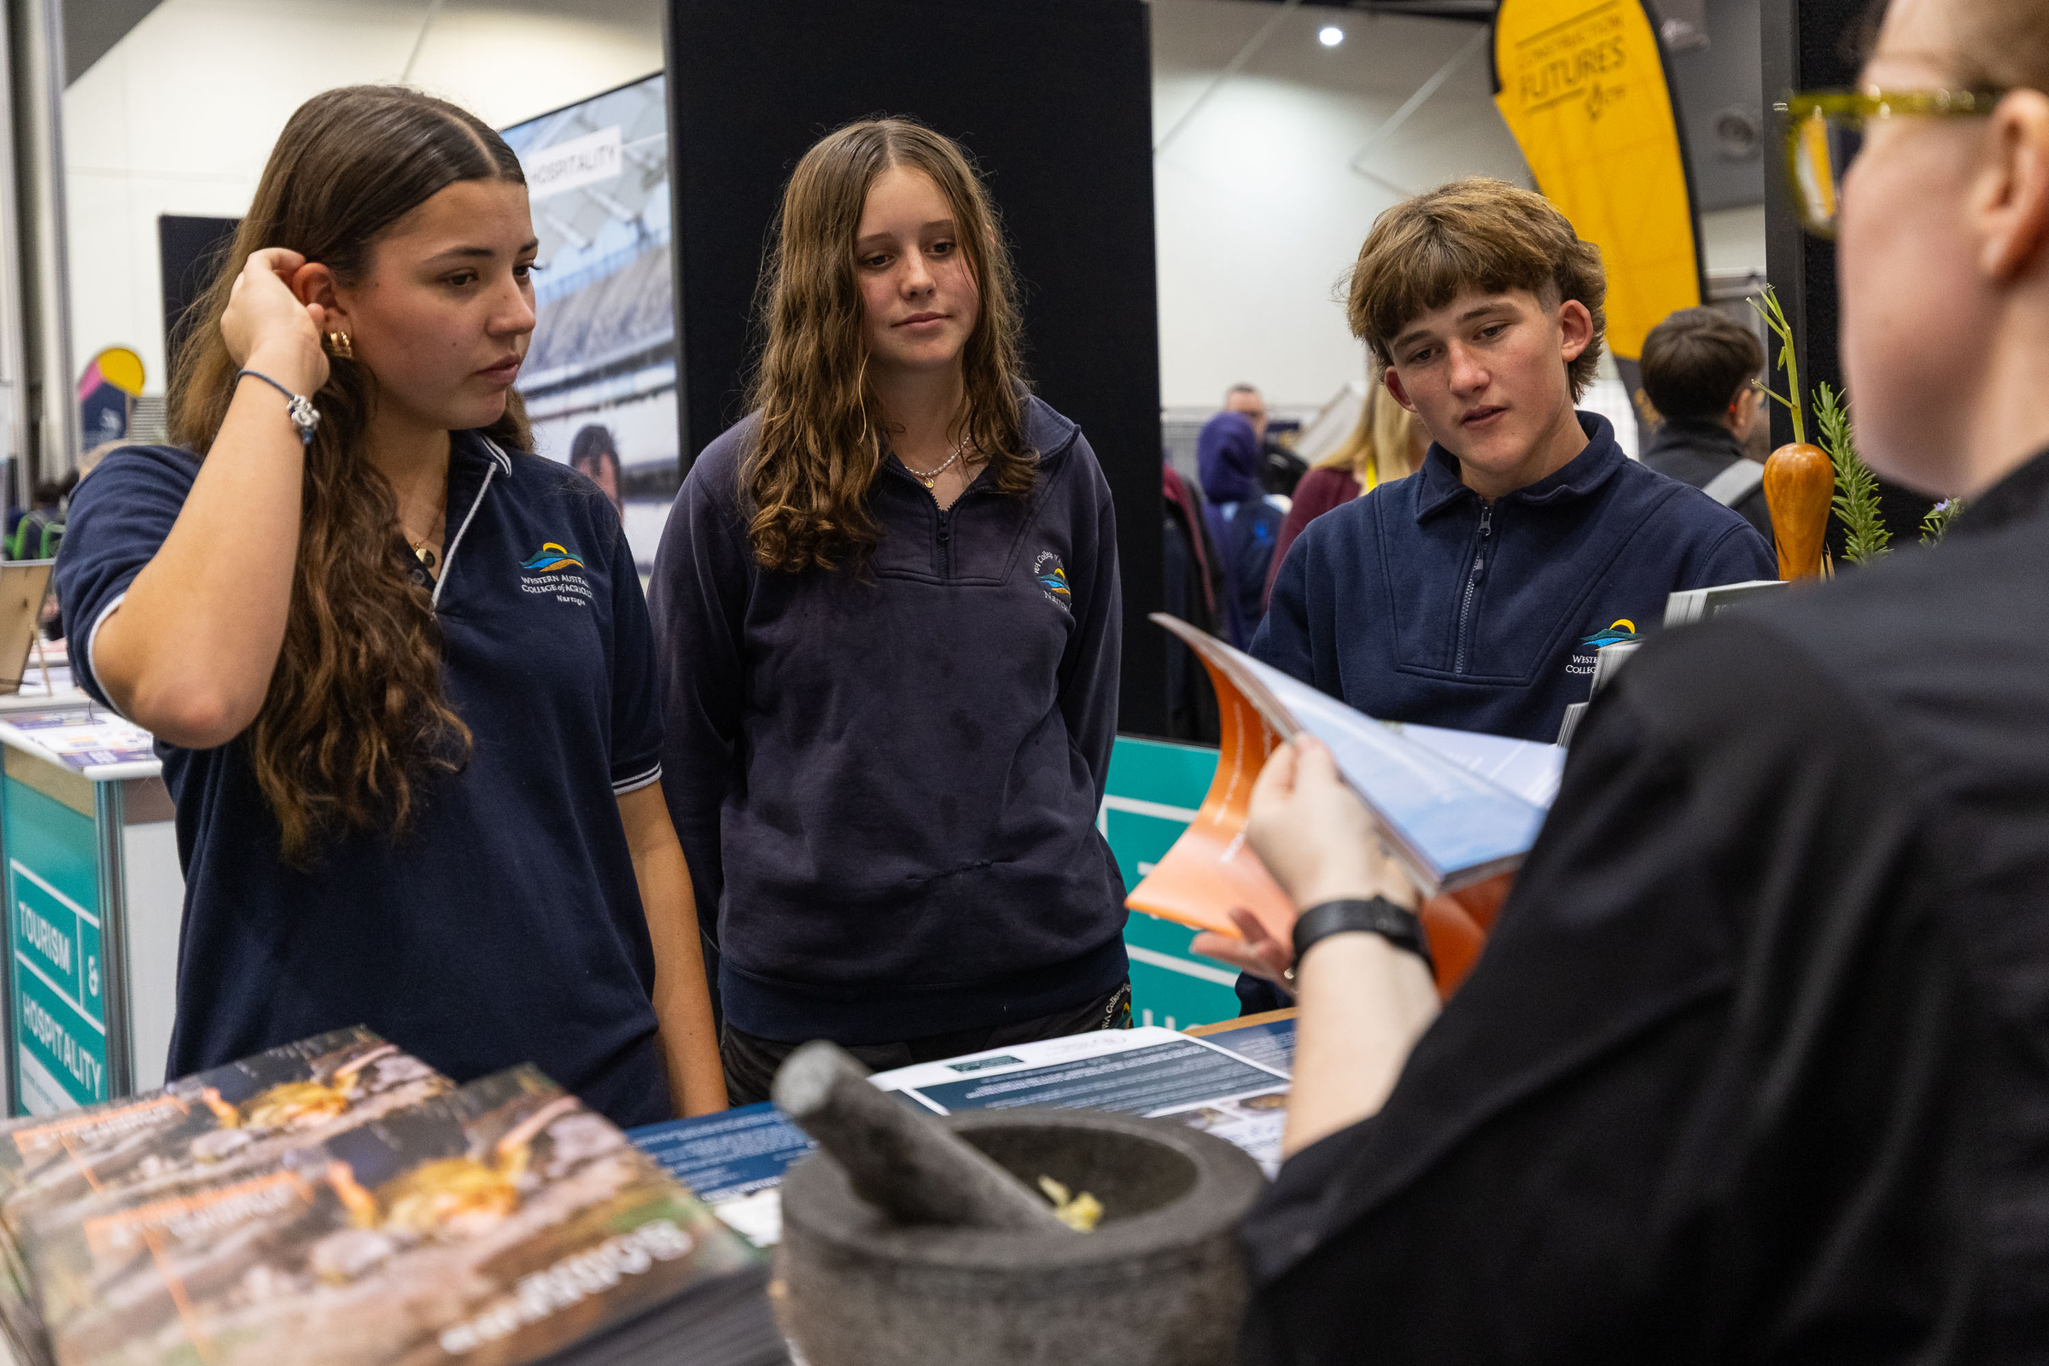
Tourism & Hospitality Opportunities at School
Students can start building their tourism and hospitality careers while still at school.
Work Experience &
  Industry Placements
  Short placements with hotels, cafés, tour operators or visitor centres
  Helps students explore careers before committing
  Builds confidence and resumes.
VET in Schools (VETiS)
Study tourism or hospitality certificates at school.
Learn practical, job-ready skills.
Count toward WACE and future pathways.
  Ways Students Can Get Involved
School-Based Apprenticeships & Traineeships (SBATs).
Combine paid work + school + training
Work part-time in tourism or hospitality while completing Year 11–12.
Gain a nationally recognised qualification
Get a head start into the industry.
Events, Excursions &
  Industry Programs
Industry talks, tours, camps
  and career days.
Meet real employers
  and professionals.
  Learn what tourism and hospitality look like in action.
  ⭐ Benefits for Students ⭐
  ✔ Earn while learning
  ✔ Build real-world skills
  ✔ Explore careers early
  ✔ Strengthen resumes
  ✔ Create industry connections
  Part-Time & Casual Work
  Many students work in cafés, restaurants, events and attractions
  Develop customer service, teamwork and time management skills
  Earn money while studying.

Slide 16
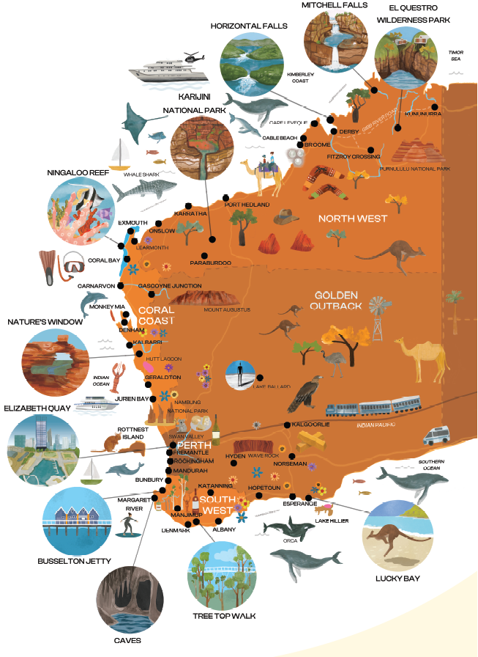
Follow the Sun – Gap Year Opportunities
Help your Year 12s explore tourism and hospitality pathways that combine work, travel and skills development across WA.
Why a Gap Year in Tourism & Hospitality?
  Grow real skills that transfer to any future career
  Work and travel across Australia’s most scenic regions
  Gain industry experience that looks great on resumes
  Connect with diverse people, cultures and workplaces
Peak Working Times Around WA
Metro Area (Perth & Peel Regions)
Busy all year round
South West (South West & Great Southern Regions)
Busy spring & summer (September – April)
North West (Coral Coast, Golden Outback and Kimberly Regions)
Busy autumn & winter (April – September)
Notes:
Australia's South West Seasonal Tourism and Hospitality Jobs for young people to consider:
- Work in hotels, caravan and holiday parks, kitchens, bars, cafes, restaurants in beautiful venues on vineyards, beaches, small towns, forests.
- Work in adventure tourism attractions like ziplines, kayak tours, hiking tours on the Bibbulmun Track and Cape to Cape,
Australia’s North West, Golden Outback and Coral Coast Seasonal Tourism and Hospitality Jobs:
- Work in hotels, caravan and holiday parks, kitchens, bars, cafes, restaurants in beautiful venues on beaches, gorges, small towns, remote locations
- Work in adventure tourism attractions like deckhands and catering on fishing charters, hospitality at Karijini Eco Resort or on a farm station like Wooleen, spend a season as a camel guide in Broome

Slide 17
Follow the Sun – Gap Year Opportunities
Help your Year 12s explore tourism and hospitality pathways that combine work, travel and skills development across WA.
Key Opportunities for Students
Work & Travel (Working Holiday)
  Students can take casual and seasonal roles in tourism/hospitality while exploring WA
  Great for earning money and building experience
Job-Ready Training & Workshops
  Workforce development programs across WA deliver short training, skills workshops and employer connections
  Practical and industry-focused learning
Seasonal & Casual Jobs
  Hospitality venues, visitor centres, tours and attractions hire seasonal staff
  Common in busy regional areas during peak tourism periods
Internships & Industry Placements
  Short placements with tourism operators or events deliver hands-on experience
  Can help students decide career direction
WA Tourism Jobs Portal
Teachers can direct students to westernaustralia.jobs, which lists tourism, hospitality and event roles across the State.

Slide 18
Hospitality
The Arts
Curriculum Connections
Do you have students with
an interest in Tourism & Hospitality?
Turn their interests into a career!
Here are some jobs they could explore!
Math
Outdoor
HASS
Design

Slide 19
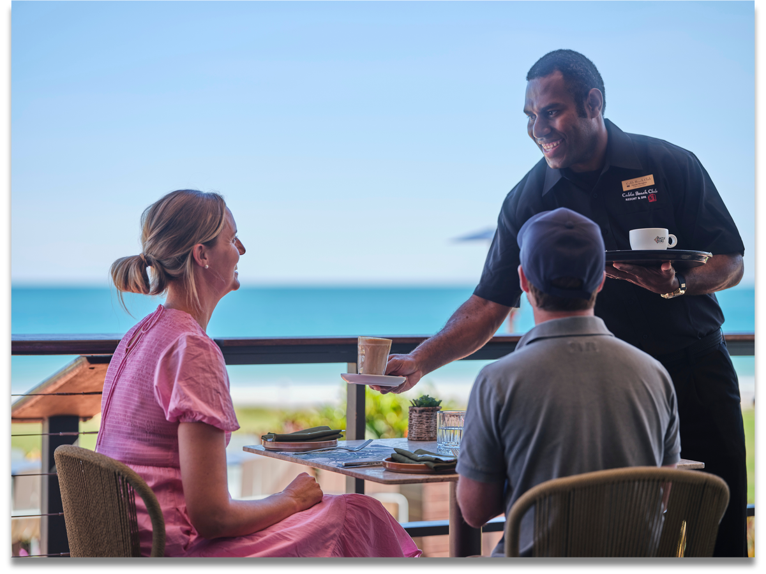
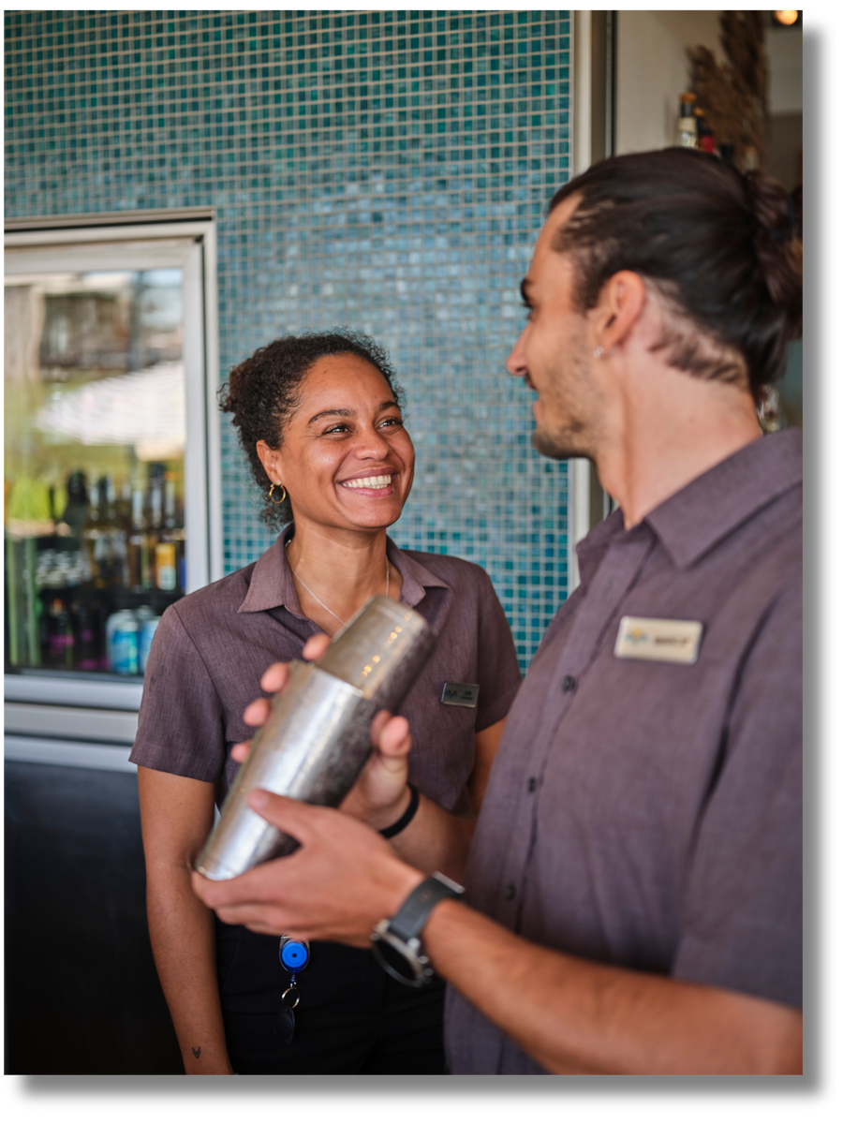

Interested in Hospitality,
Home Economics or
Food Science?
Hospitality
The Arts
These are the jobs they might be interested in...
Math
Outdoor
Chef / Cook
Bartender or Sommelier
Venue Manager
Event Coordinator
Hotel / Resort Staff
Food Stylist / Food Photographer
Pop-Up Event Chef / Coordinator
Product Development Manager
HASS
Design

Slide 20

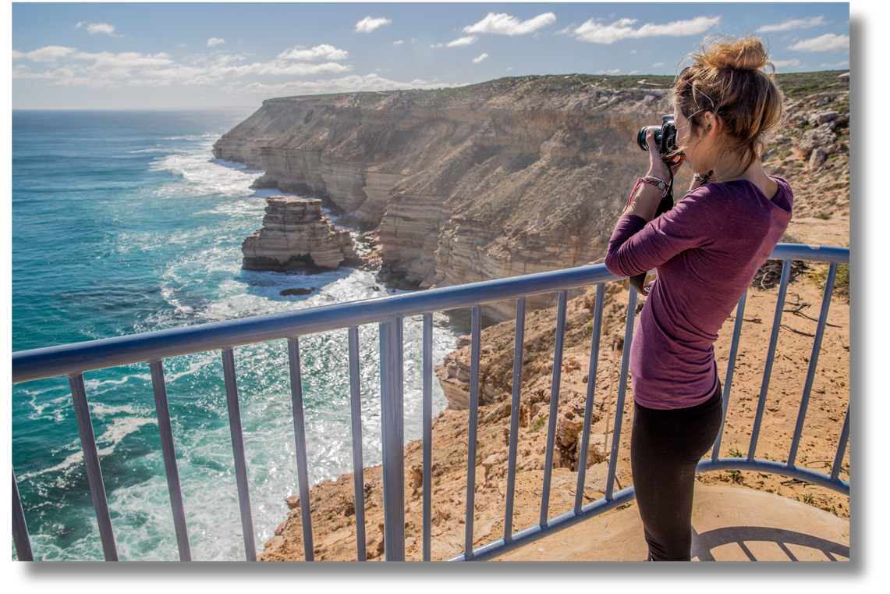

Interested in Drama, Art, Photography or English?
Hospitality
The Arts
Math
These are the jobs they might be interested in...
Outdoor
Travel & Food Writer/Blogger
Marketing & Social Media Specialist
Art/heritage walking tour guides
Tourism Guide / Presenter
Food & Travel Photographer / Content Creator
Performer
Gallery and museum managers
Interior Designer for Hotels & Restaurants
HASS
Design

Slide 21
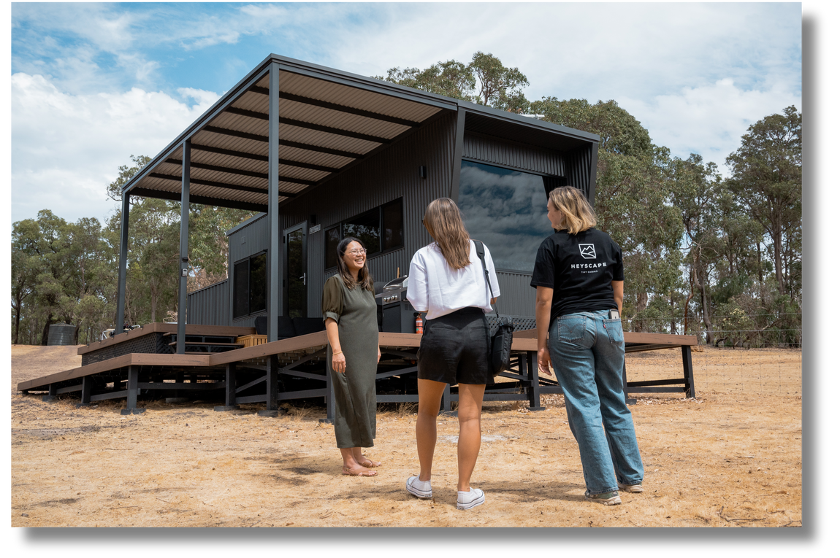
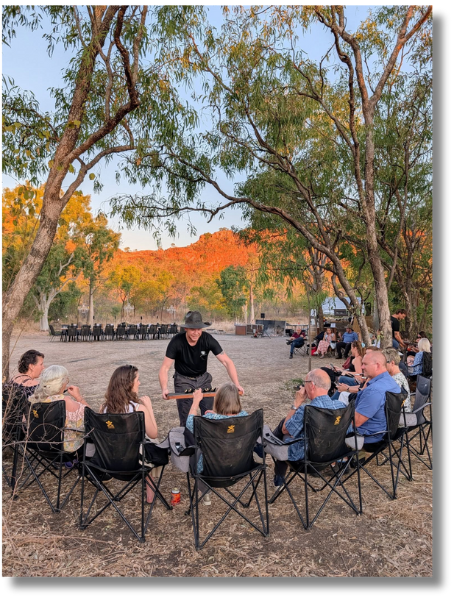
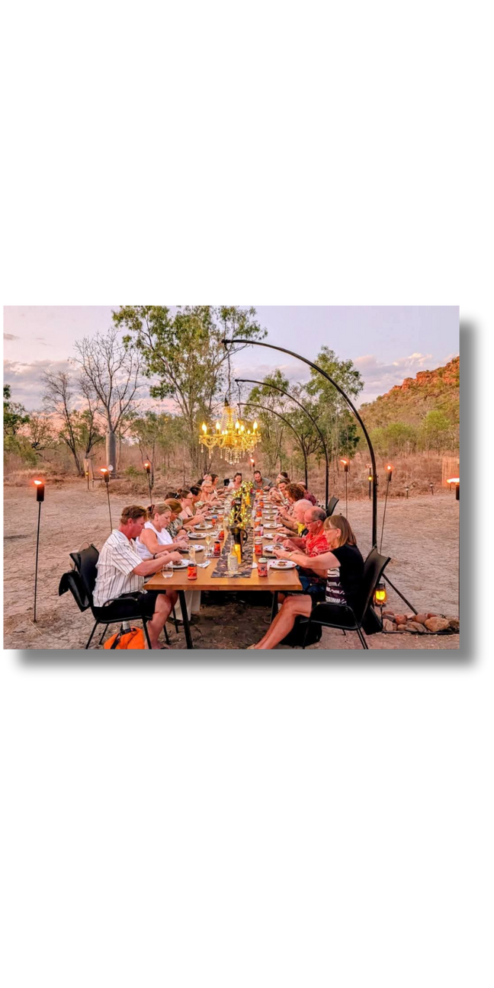
Interested in Mathematics, Business or
Economics?
Hospitality
The Arts
Math
These are the jobs they might be interested in...
Outdoor
Hotel or Restaurant Manager
Event Planner / Coordinator
Travel Consultant / Tour Operator
Revenue / Financial Analyst
Financial / Accounts Manager
Human Resources Manager
Marketing & Sales Specialist
Hospitality Entrepreneur
HASS
Design

Slide 22
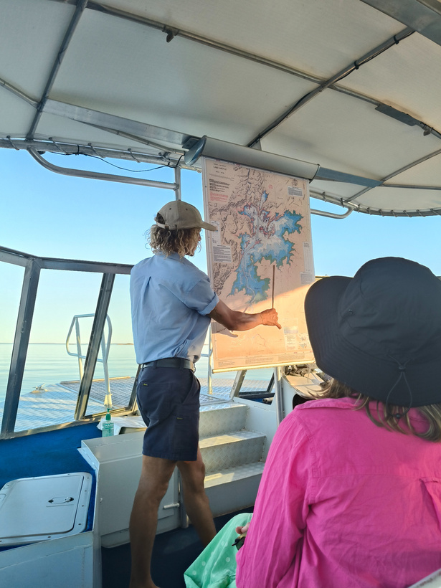

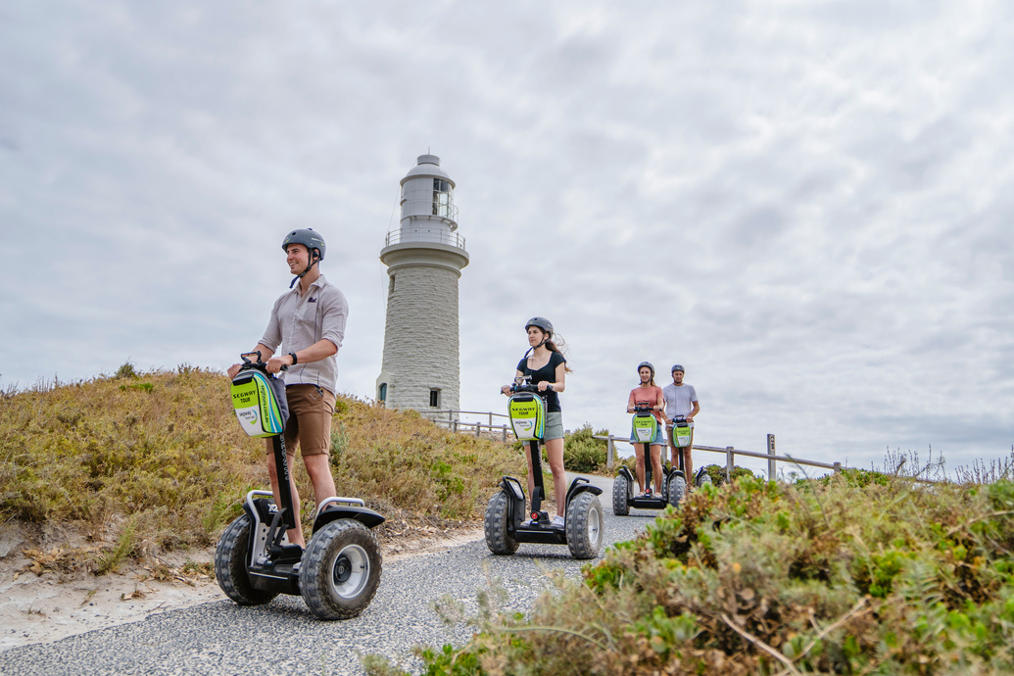
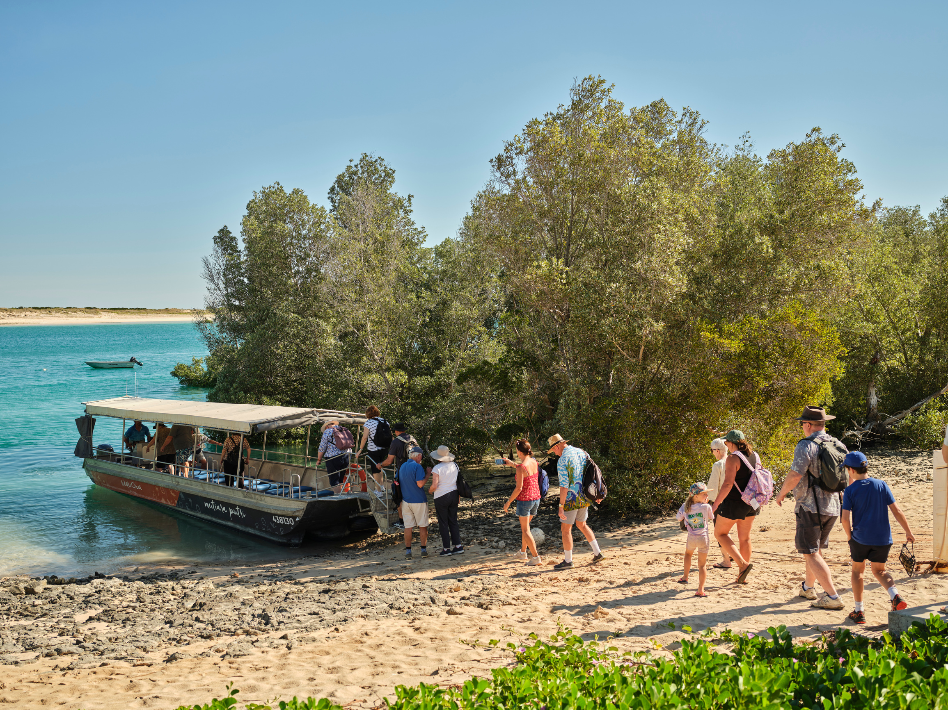
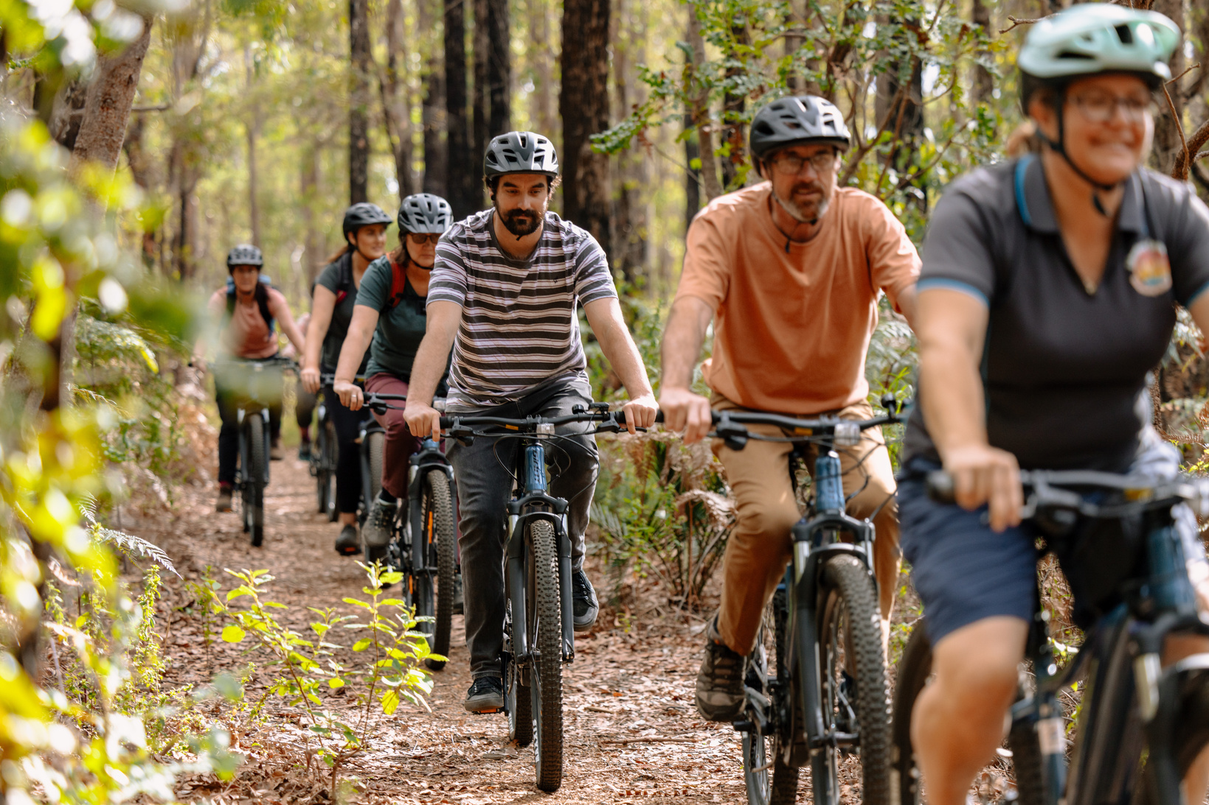
Interested in Health, Physical Education, Sport and Recreation
or Science?
Hospitality
The Arts
Math
These are the jobs they might be interested in...
Outdoor
Wellness & Spa Manager / Therapist
Fitness Instructor / Personal Trainer
Adventure / Outdoor Activity Guide
Eco or sustainability tour guide
Health & Safety Officer
Nutritionist / Food Scientist
Animal Husbandry / Farm & Wildlife Care
Recreation Program Coordinator
HASS
Design

Slide 23
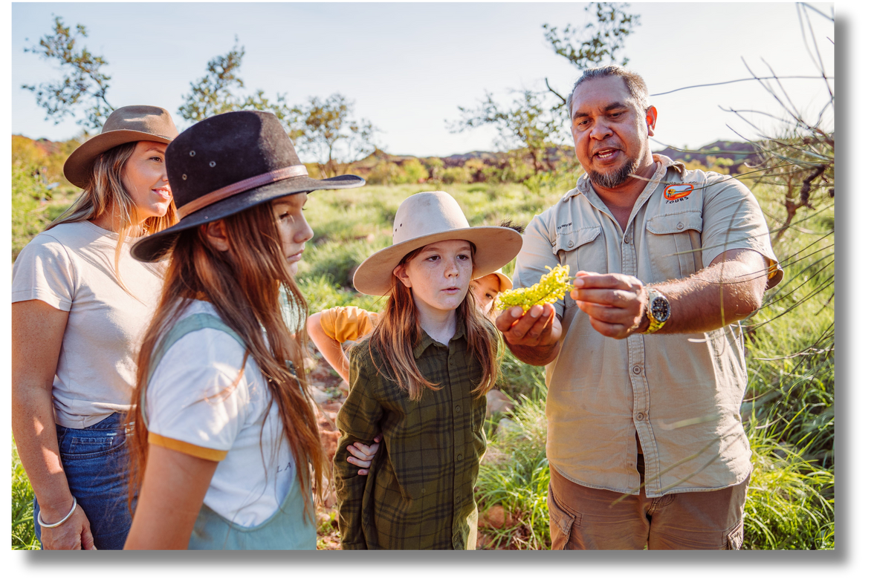
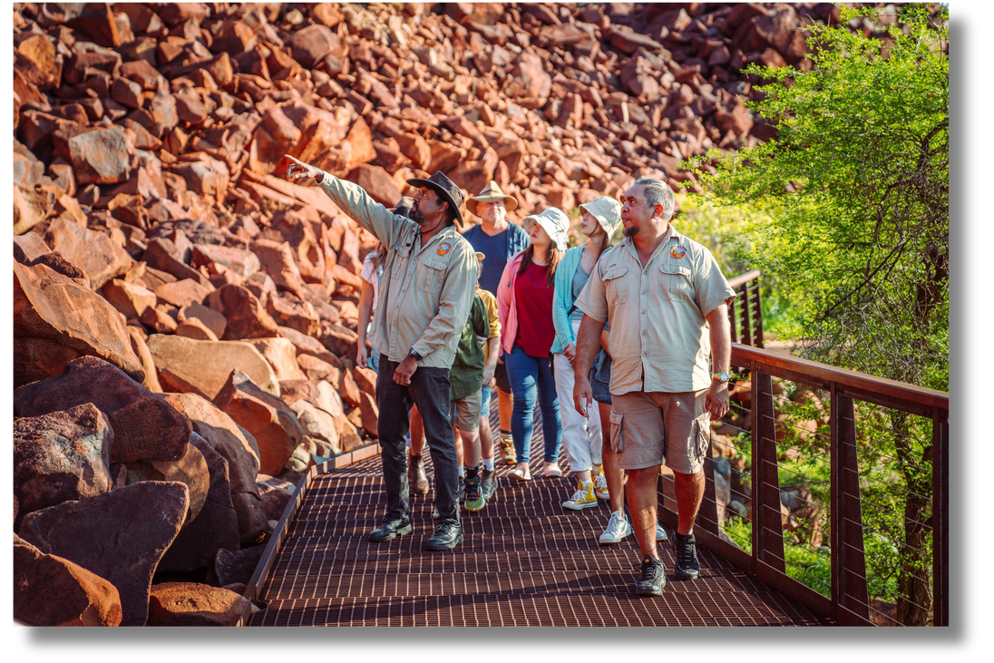
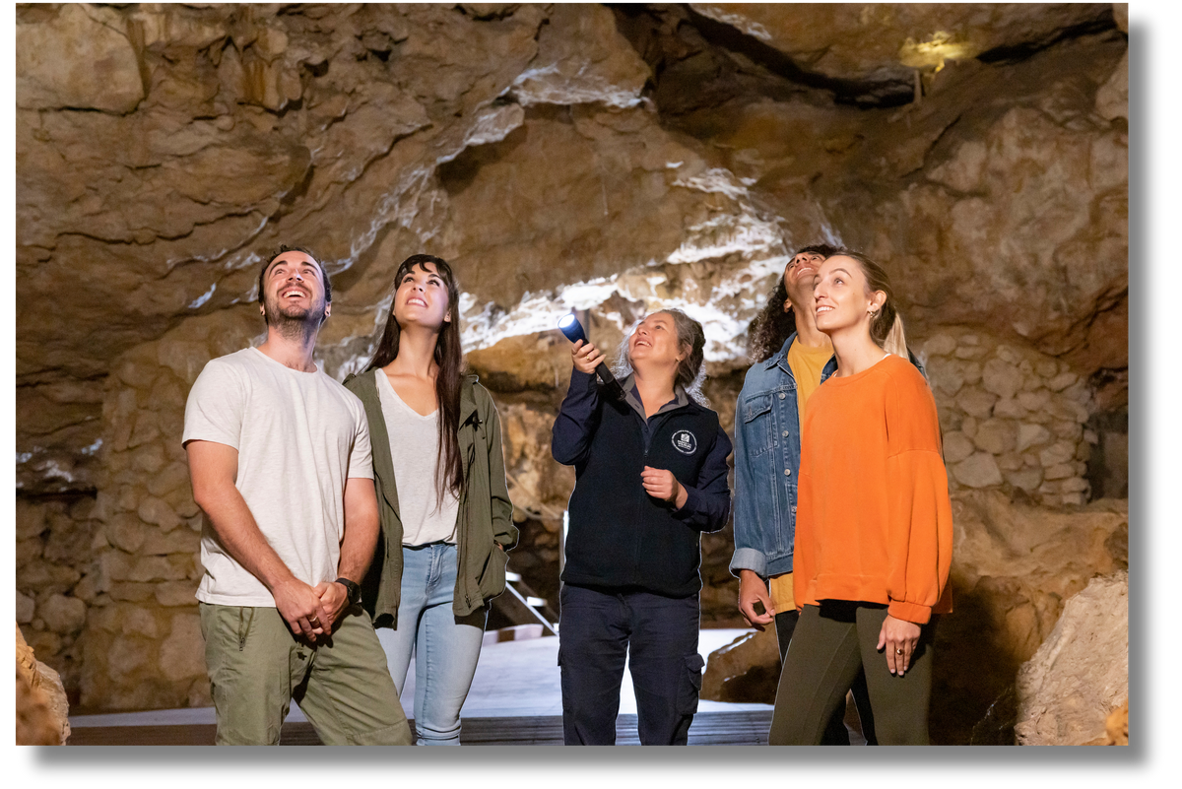
Interested in History, Cultural Studies, Humanities / Social Sciences or Languages?
Hospitality
The Arts
These are the jobs they might be interested in...
Math
Outdoor
Tour Guide / Cultural Guide
Heritage or Historical Site Staff
Travel Consultant / Tour Operator
Interpreter / Translator
Event Coordinator
Aboriginal Tour Operator
Aboriginal Ranger / On Country Ranger
Community Engagement / Visitor information Officer
HASS
Design

Slide 24
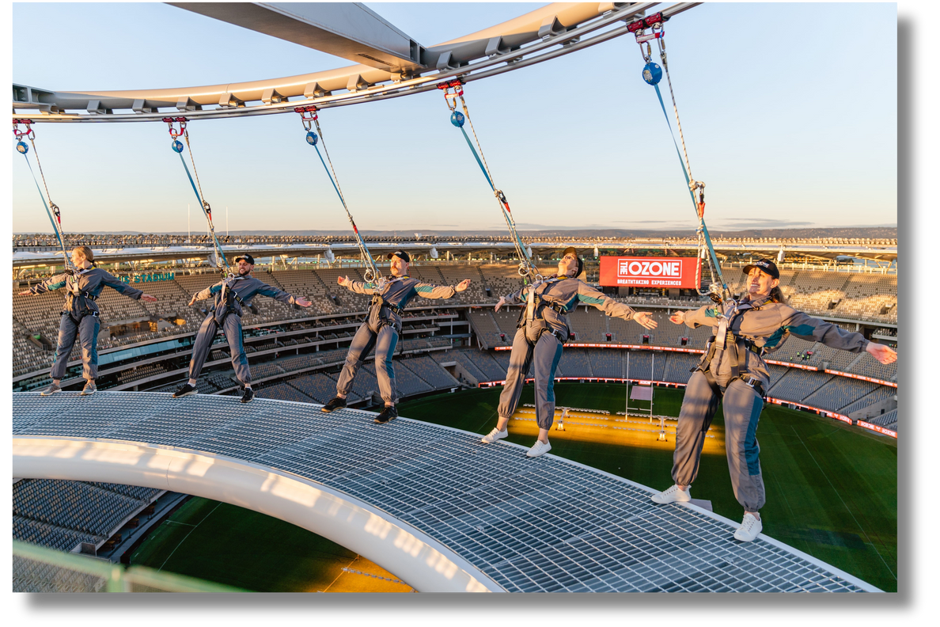
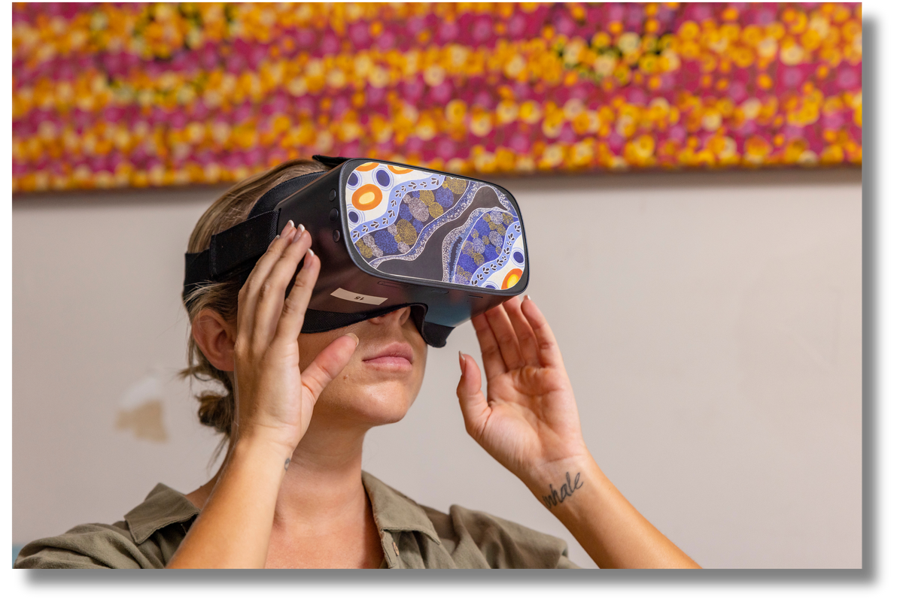
Interested in Information Technology, Automotive, Construction, Design and Technology?
Hospitality
The Arts
These are the jobs they might be interested in...
Math
Outdoor
Theme Park / Attraction Technician
Design and venue construction
Transport / Fleet Manager
Virtual Reality Tours
Hotel / Resort Facilities Manager
Event Technology / AV Specialist
Tourism IT Specialist / Systems Analyst
Aviation
HASS
Design

Slide 25
Hospitality
The Arts
Curriculum Connections
Do you have students with an interest in
Tourism & Hospitality?
Turn their interests into a career!
Here are some jobs they could explore!
Math
Outdoor
HASS
Design

Slide 26
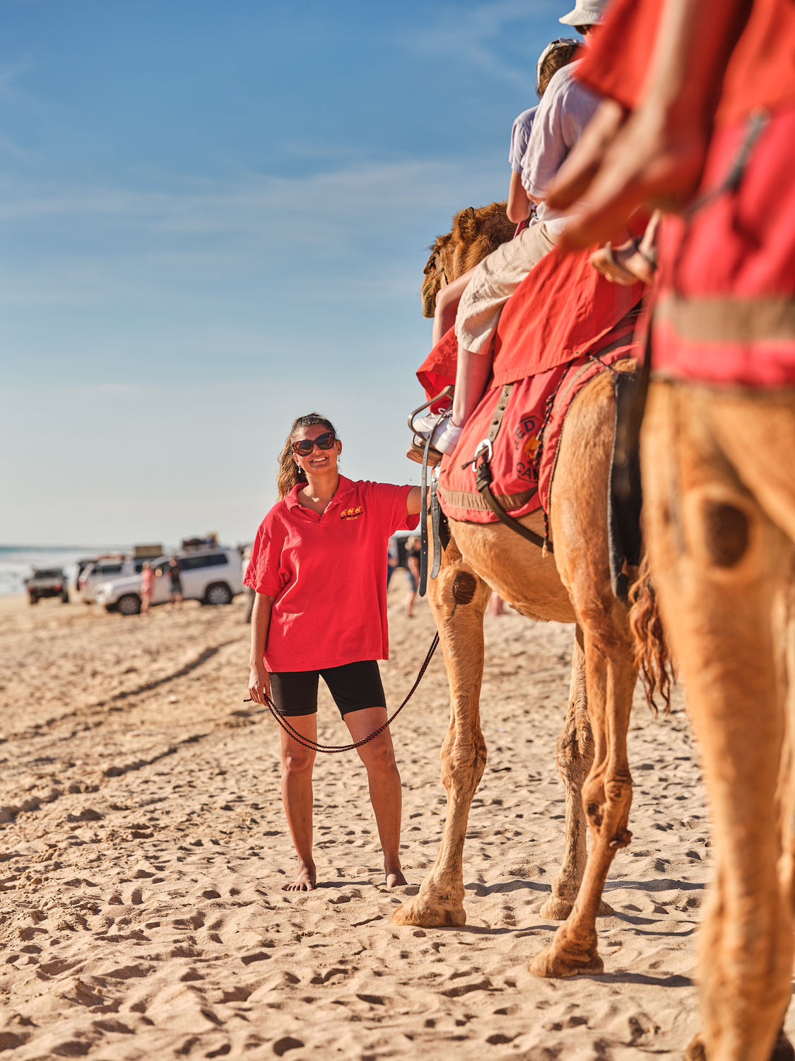
Exploring Your Interests Through Tourism & Hospitality
Activity Suggestion:
Find Your Tourism Job
Step 1: Choose your favourite school subject.
Step 2: Think about what you’re good at.
Step 3: Match it to a Tourism & Hospitality career in WA.
💬 Be ready to share your pick!
Check out the additional activity suggestions PDF
for more activities.

Slide 27
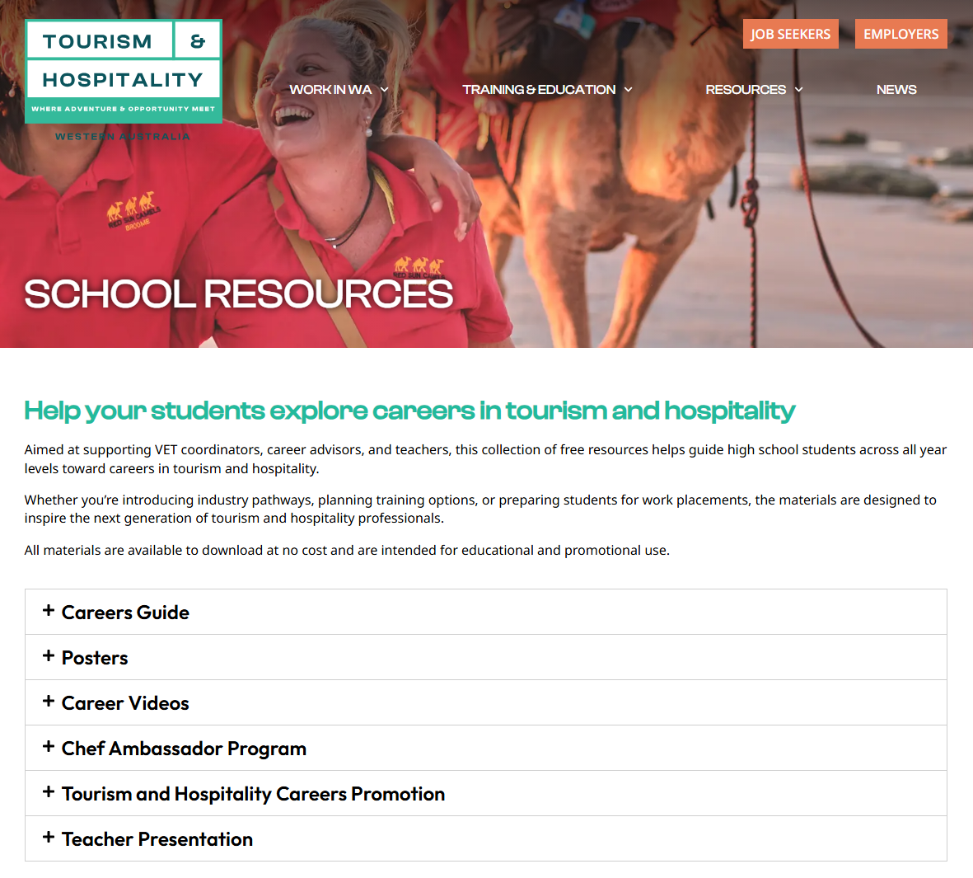
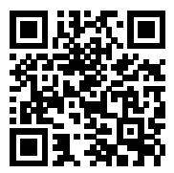
RESOURCES
WESTERNAUSTRALIA.JOBS
ARE YOUR STUDENTS LOOKING FOR WORK EXPERIENCE?
Looking to gain real-world experience in
tourism and hospitality?
Work placements and work experience are excellent ways to explore the many exciting career paths in this vibrant industry.​
​Head to westernaustralia.jobs for a list of participating employers who are open to student work placements​.
View , download or order copies
FREE teacher & student resources
Notes:
Not sure where to go next?
Check out Tourism and Hospitality Jobs in Western Australia , WA’s dedicated tourism and hospitality jobs and careers portal. It features live WA job listings, and our School Resources tab has a custom-made WA Tourism and Hospitality Careers Guide and Career Videos to inspire you. Industry Toolkit | Tourism & Hospitality Jobs (westernaustralia.jobs)
Careers Guide & Career Vignettes
Help students explore their options with this practical guide to studying and working in the industry. Whatever their interests, there is plenty to inspire your students to take the next step. Workforce Development 2025 Career Guide by Tourism... – Flipsnack
View electronic version, download a copy and order printed copies
Watch inspiring career vignettes for young Aboriginal people
Bring the industry to life with short, engaging videos featuring real professionals sharing their stories. Ideal for classroom use or career presentations. Aboriginal Tourism & Hospitality Career Profiles – YouTube
Watch inspiring videos and copy links for presentations
Young People with Disabilities Careers Toolkit
See how your students can thrive in a welcoming and diverse industry. Promoting inclusivity in the workforce, the toolkit includes an online quiz. Toolkit | Hospitality Disability Network, Career Quiz | Hospitality Disability Network
Book your free in-school visit
Bring the industry into your classroom and invite a passionate professional to share their story.
Get students fired up with a live cooking demo and chat with one of the super chefs involved in our Chef Ambassador Program.
Give them a taste of other exciting roles in this industry, from marine guide to hotel manager, with our Tourism & Hospitality Careers Program.
Both programs are subject to availability. To enquire, email us at workforce@westernaustralia.com
11

Slide 28

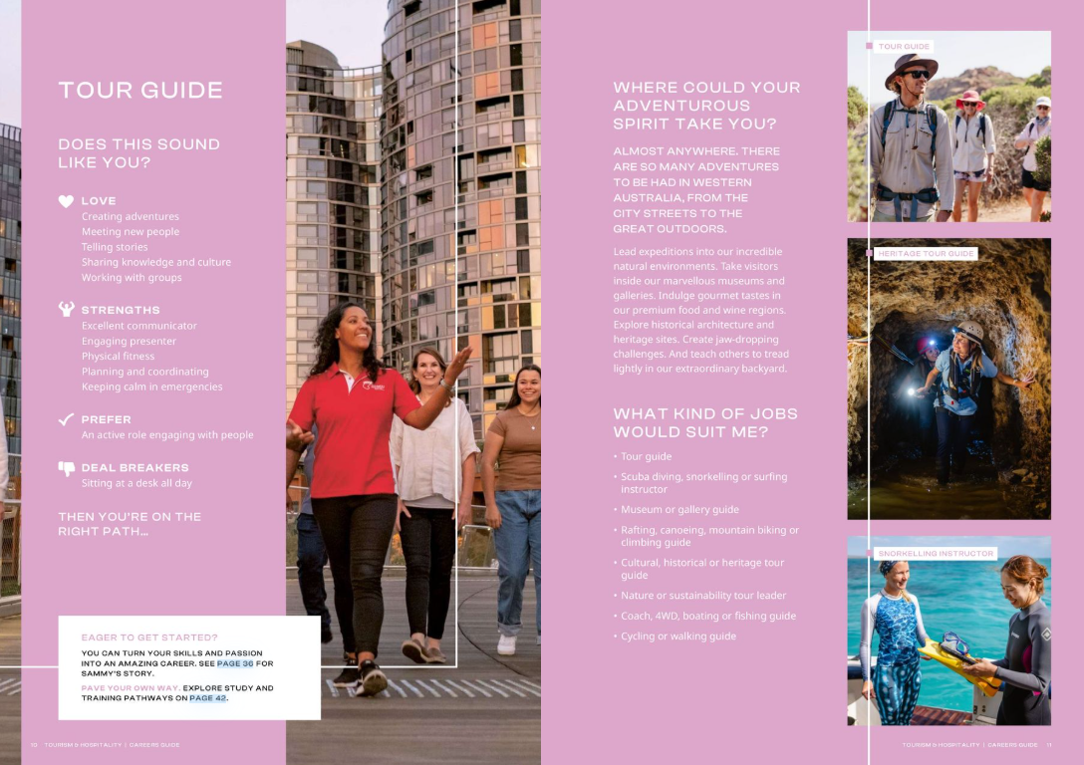
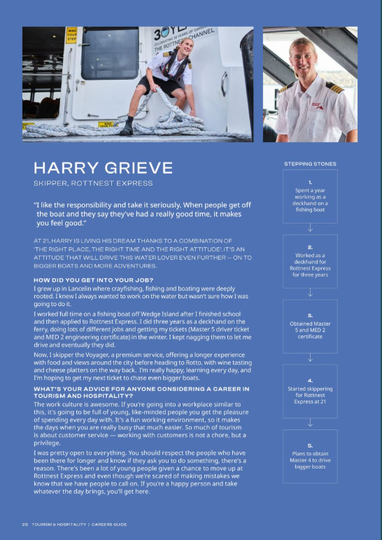
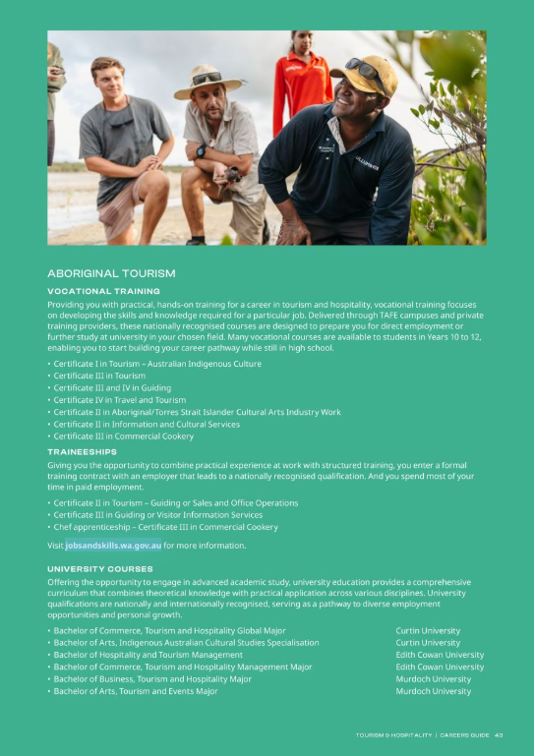
RESOURCES
Navigating the Tourism and Hospitality Careers Guide

Slide 29
RESOURCES
Careers Guide
Job profiles to match your personality with a career in tourism and hospitality.

Slide 30
RESOURCES
Careers Guide
Career Spotlights on locals working in the industry.

Slide 31

RESOURCES
Careers Guide
Read more on training and education pathways.

Slide 32
RESOURCES
NEXT STEPS:
WESTERNAUSTRALIA.JOBS
  Encourage students to read the Tourism and Hospitality Careers Guide
  Share the Career Vignette links with students
  Download the student presentation and present to your students
REGISTER FOR IN-SCHOOL VISIT
  Book a free Tourism and Hospitality Careers Program session workforce@westernaustralia.com
  Book a free in class Chef Ambassador Program session chefambassador@hgtwa.com.au
CAREER EXPOS
  Come say hello at Perth Careers Expo in May 2026.
Please feel free to send any general tourism and hospitality queries to workforce@westernaustralia.com
Notes:
Note: This slide is background information for teachers only. Please feel free to delete or skip when presenting to students.
17

Slide 33
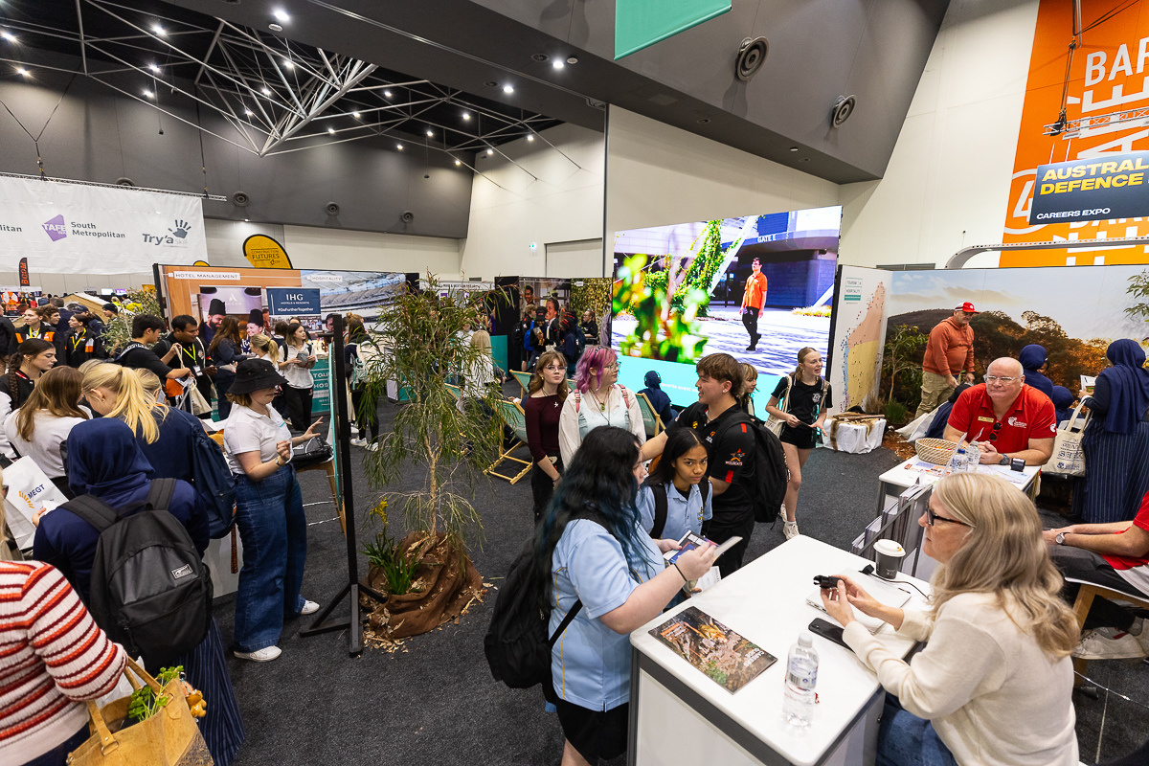

RESOURCES
For students wanting advice on apprenticeships, traineeships, resume writing, interview skills, one on one career guidance and career planning direct them to your local Jobs and Skills Centre this is a free service.
Jobs and Skills Centers
NORTH METRO
Balga: balgajsc@nmtafe.wa.edu.au
Perth: perthjsc@nmtafe.wa.edu.au
Midland: midlandjsc@nmtafe.wa.edu.au
Joondalup: joondalupjsc@nmtafe.wa.edu.au
NORTH REGIONAL
Broome: broomejsc@nrtafe.wa.edu.au
Karratha: karrathajsc@nrtafe.wa.edu.au
Kununurra: kununurrajsc@nrtafe.wa.edu.au
South Hedland: hedlandjsc@nrtafe.wa.edu.au
    SOUTH REGIONAL
Collie: colliejsc@srtafe.wa.edu.au
Albany: albanyjsc@srtafe.wa.edu.au
    Bunbury: bunburyjsc@srtafe.wa.edu.au
CENTRAL REGIONAL
Northam: wheatbeltjsc@crtafe.wa.edu.au
Geraldton: midwestjsc@crtafe.wa.edu.au
Kalgoorlie: goldfieldsjsc@crtafe.wa.edu.au
SOUTH METRO
Thornlie: thornliejsc@smtafe.wa.edu.au
Peel (Mandurah): peeljsc@smtafe.wa.edu.au
Armadale: armadalejsc@smtafe.wa.edu.au
Fremantle: Fremantle.jsc@smtafe.wa.edu.au
Rockingham: rockinghamjsc@smtafe.wa.edu.au

Slide 34

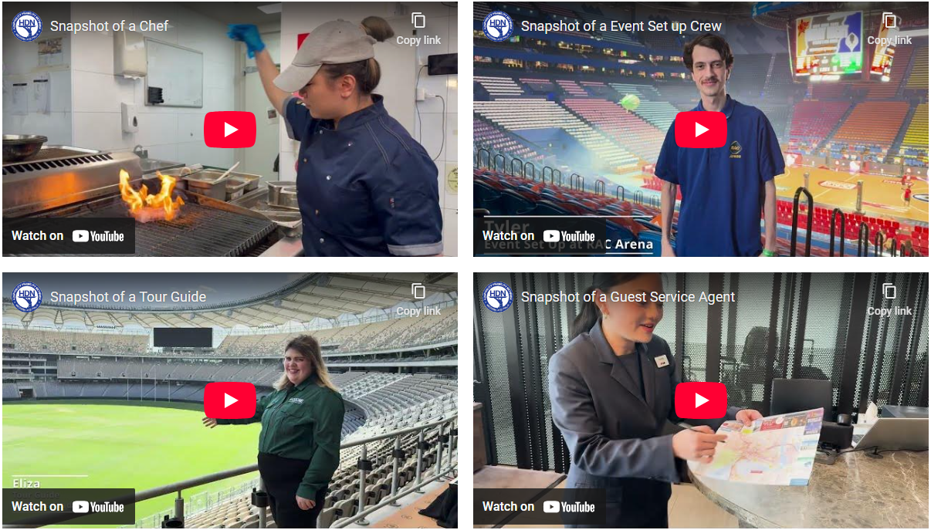
HOSPITALITY DISABILITY NETWORK
Tourism & Hospitality
for Every Learner
Tourism and hospitality careers are inclusive, adaptable, and practical.
Perfect for students with different learning styles and goals.
HDNs purpose is to support the tourism and hospitality industry in Western Australia to increase sustainable employment opportunities for people with a disability.
Tool Kit & Online Quiz - https://hdnwa.org.au/
Notes:
HDNWA and Tourism Western Australia are at the forefront of promoting disability employment in Western Australia's tourism and hospitality sectors.

Slide 35


Career Profile: Rhys Speyer, Tour Guide,
Matagarup Zip+Climb | Perth
Notes:
Credit: Tourism WA Image Library.

Slide 36
Career Profile: Thomas Shann, Business Development Manager,
Pullman Bunker Bay Resort | South West
Notes:
Credit: Tourism WA Image Library.

Slide 37
Career Profile: Lily Fenton, Tour Guide,
Margaret River Caves | South West
Notes:
Credit: Tourism WA Image Library.

Slide 38
Career Profile: Alex McDonagh, Hospitality Worker,
Optus Stadium | Perth
Notes:
Credit: Tourism WA Image Library.

Slide 39
Career Profile: Jordan Kazirer, Bus Driver and Tour Host,
Exmouth Dive and Whalesharks | Exmouth
Notes:
Credit: Tourism WA Image Library.

Slide 40
Career Profile: Dean Huxley, Operations Director,
WA Wildlife | Perth
Notes:
Credit: Tourism WA Image Library.

Slide 41


START YOUR ADVENTURE TODAY!
VISIT WESTERNAUSTRALIA.JOBS
Notes:
16

